Slide 1

Red Hat Enterprise Linux 8
Hsu Zarni Maung

Slide 2
What is Red Hat Linux?
The Red Hat business model is based on an open source ecosystem, where collaborative development occurs within a community of professionals focused on providing quality assurance, testing and customer support
Red Hat offers a variety of open source software that DevOps engineers and businesses use
These include operating system platforms, storage, middleware, management products, as well as training, support and consulting services
Currently, Dell, IBM and Oracle support the Red Hat platform and open source community of applications

Slide 3
The history of Red Hat
Today, the "Red Hat Plan" is often discussed in business schools as a model for making customer support a company's primary product
Red Hat became a business unit of IBM's Hybrid Cloud team, while continuing to preserve the independence and neutrality of Red Hat's open source development heritage
Red Hat was one of the first companies to realize that free software could be sold as a product

Slide 4
Red Hat Products
Red Hat Ansible: An open source IT configuration management (CM) developer tool and IT automation platform
Red Hat Atomic Host: A variant of Red Hat Enterprise Linux with optimizations for container application platform hosting
Red Hat CloudForms: A virtual machine and container management product based on VMware, Red Hat Virtualization, Microsoft Azure, OpenStack, AWS EC2, Google Cloud and Red Hat OpenShift
Red Hat Enterprise Linux (RHEL): A distribution of the Linux operating system developed for the business market that provides centralized certificate administration and cloud security updates

Slide 5
Red Hat Products
Red Hat OpenShift Container Platform: A cloud computing, microservices container platform used in conjunction with the Kubernetes to deliver traffic and identity management, telemetry and policy enforcement
Red Hat OpenStack Platform: A commercially supported distribution of open source software designed to build and manage large pools of computing, storage and networking resources in a multi-cloud infrastructure
Red Hat Package Manager (RPM): A program for installing, uninstalling and managing software packages in Linux

Slide 6
Red Hat Products
Red Hat Satellite: An IT infrastructure management tool primarily used to monitor and manage Red Hat Enterprise Linux environments. Satellite is part of Red Hat's four-piece systems management tool set for enterprise IT, which also includes Ansible, CloudForms and the Red Hat Insights service
Red Hat Storage (RHS): A distributed file system that acts as scale-out network-attached storage (NAS) and object storage
Red Hat Virtualization (RHV): An enterprise-class virtualization platform

Slide 7
Red Hat Enterprise Linux 8
Easier adoption (for staff new to Linux)
More subscription value (with Red Hat insights, now included in all Red Hat Enterprise Linux subscriptions)
Increased speed and ease
A consistent experience
Eased transition
Broad ecosystem

Slide 8

The foundation of digital transformation
Digital transformation can be done with Linux
Red Hat Enterprise Linux provides an intelligent OS that is the consistent foundation for the enterprise hybrid cloud. It allows you to deliver any application on any footprint at any time, giving you control, confidence, and freedom

Slide 9

Reality for customers
Cloud is the new normal
APIs are the future
Finding talent is hard
Complexity maintenance security

Slide 10

Linux is foundation
Digital transformation can ONLY be done with Linux
Only Red Hat Enterprise Linux provides an intelligence OS that is the consistent foundation for the enterprise hybrid cloud
Delivering any application on any footprint at any time giving you Control.Confidence.Freedom

Slide 11

Reduce the friction and cost of change in the support of service delivery
Faster, more consistent delivery in an deployment footprint with full-coverage native automation
Leading, security-focused platform in any cloud infrastructure and for emerging workloads, like machine learning
Seamless, nondisruptive migration process for existing Red Hat Enterprise Linux deployments
Faster training for non-Linux users without fear of the command line

Slide 12

Increase agility and reduce time to market of critical business workloads
Faster time to “hello world” with streamlined access to high-quality open source development tools
Leading database partner for Oracle, SAPHANA, Microsoft SQL Server, and Postgres
Eased transition to and adoption of containerized workloads with the inclusion of new container tools
Red Hat Insights included with every Red Hat Enterprise Linux subscription

Slide 13
Shell Basics
Commands entered at the shell prompt have three basic parts:
Command to run
Options to adjust the behavior of the command
Arguments, which are typically targets of the command
The command is the mane of the program to run. It may be followed by one or more options, which adjust the behavior of the command or what it will do. Options normally start with one or two

Slide 14
Logging in to a Local Computer
To run the shell, we need to log in to the computer on a terminal. A terminal is a text-based interface used to enter commands into and print output from a computer system. There are several ways to do this.
The computer might have a hardware keyboard and display for input and output directly connected to it. This is the Linux machine’s physical console. The physical console supports multiple virtual consoles, which can run separate terminals. Each virtual console supports an independent login session. You can switch between them by pressing Ctrl+Alt and a function key (F1 through F6) at the same time. Most of these virtual consoles run a terminal providing a text login prompt, and if you enter your username and password correctly, you will login and get a shell prompt

Slide 15
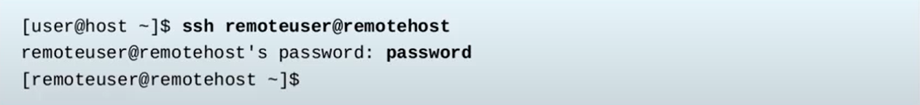
Logging in over the Network
In Linux, the most common way to get a shell prompt on a remote system is to use Secure Shell(SSH). Most Linux systems(including Red Hat Enterprise Linux) and macOS provide the OpenSSH command-line program ssh for this purpose
In this example, a user with a shell prompt on the machine host uses ssh to log in to the remote Linux system remotehost as the user remoteuser:

Slide 16
Logging Out
When you are finished using the shell and want to quit, you can choose one of several ways to end the session. You can enter the exit command to terminate the current shell session. Alternatively, finish a session by pressing Ctrl+D
The following is an example of a user logging out of an SSH session:

Slide 17
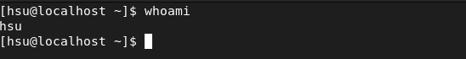
Basic Command Syntax
The GNU Bourne-Again Shell (bash) is a program that interprets commands typed in by the user. Each string typed into the shell can have up to three parts: the command, options(which usually begin with a – or --), and arguments. Each word typed into the shell is separated from each other with spaces. Commands are the names of programs that are installed on the system. Each command has its own options and arguments
When you are ready to execute a command, press the Enter key. Type each command on a separate line. The command output is displayed before the next shell prompt appears

Slide 18
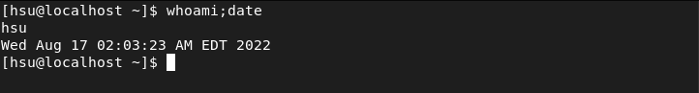
Basic Command Syntax(Con’d)
If you want to type more than one command on a single line, use the semicolon(;) as a command separator. A semicolon is a member of a class of characters called metacharacters that have special meanings for bash. In this case the output of both commands will be displayed before the next shell prompt appears.
The following example shows how to combine two commands(command1 and command2) on the command line

Slide 19
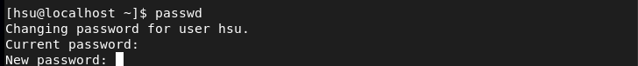
Basic Command Syntax(Con’d)
usermod
passwd-this is allowed to change your own password

Slide 20
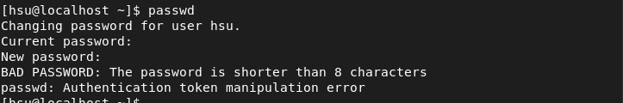
Basic Command Syntax(Password)
If you set your password that the length of password is less than eight

Slide 21
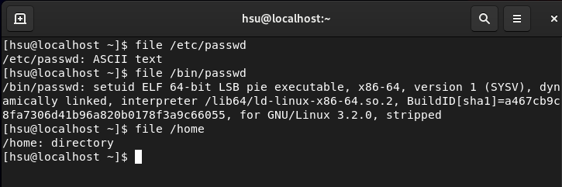
Basic Command Syntax(File)
Linux does not require file name extensions to classify files by type. The file command scans the beginning of a file’s contents and displays what type it is. The files to be classified are passed as arguments to the command

Slide 22
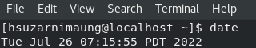
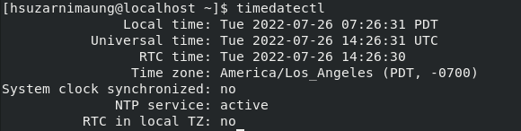
Displaying the current date and time
Enter the date command
To see more detail, use the timedatectl command
Note: You want to see more date command: man date and man timedatectl

Slide 23
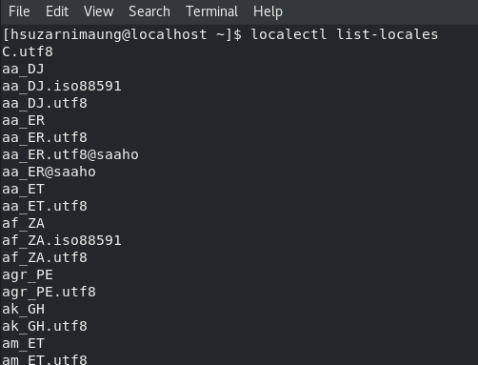
Configuring the system locale
System-wide locale settings are stored in the /etc/locale.conf file, which is read at early boot by the systemd daemon. Every service or user inherits the locale settings configured in /etc/locale.conf, unless individual programs or individual users override them
To list available system locale setting: localectl list-locales

Slide 24
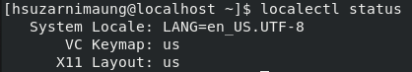
Configuring the system locale(Con’d)
To display the current status of the system locales settings: localectl status
To set or change the default system locale settings, use a localectl set-locale sub-command as the root user. For example: localectl set-locale LANG=en_US
Additional resources: man localectl, man locale, and man locale.conf

Slide 25
Configuring the keyboard layout
To list available keymaps: localectl list-keymaps
To display the current status of keymaps settings: localectl status
To set or change the default system keymap. For example: # localectl set-keymap us
Additional resources man localectl, man locale, and man locale.conf

Slide 26
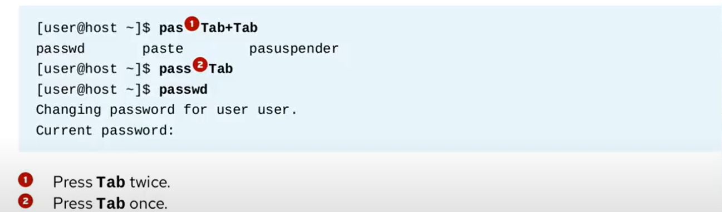
Tab Completion
Tab completion allows a user to quickly complete commands or file names after they have typed enough at the prompt to make it unique. If the characters typed are not unique, pressing the Tab key twice displays all commands that begin with the characters already typed

Slide 27
Tab Completion(Con’d)
Tab completion can be used to complete file names when typing them as arguments to commands
When Tab is pressed, it completes as much of the file name as possible
Pressing Tab a second time causes the shell to list all of the files that are matched by the current pattern
Type additional characters until the name is unique, then use tab completion to complete the command

Slide 28
Continuing a Long Command on Another Line
Commands with many options and arguments can quickly become long and are automatically wrapped by the command window when the cursor reaches the right margin. Instead, to match command readability easier, you can type a long command using more than one line
To do this, you will use a backslash character(\), referred to as the escape character, to ignore meaning of the character immediately following the backslash. You have learned that entering newline character, by pressing the Enter key, tells the shell that command entry is complete and to execute the command. By escaping the newline character, the shell is told to move to a new command line without performing command execution. The shell acknowledges the request by displaying a continuation prompt, referred to as the secondary prompt, using the greater-than character(>) by default, on an empty new line

Slide 29
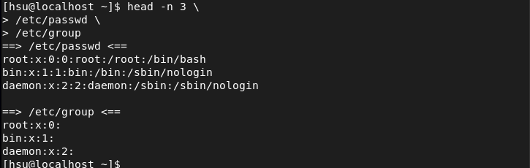
Continuing a Long Command on Another Line

Slide 30
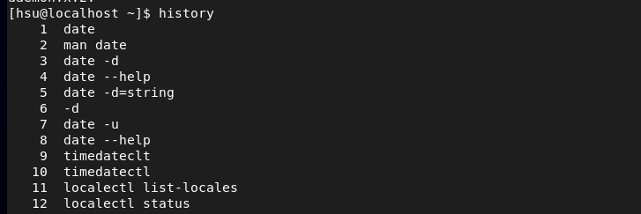
Command History
The history command displays a list of previously executed commands prefixed with a command number
The exclamation point character(!) is a metacharacter that is used to expand previous commands without having to retype them. The !number command expands to the command matching the number specified. The !string command expands to the most recent command that begins with the string specified

Slide 31
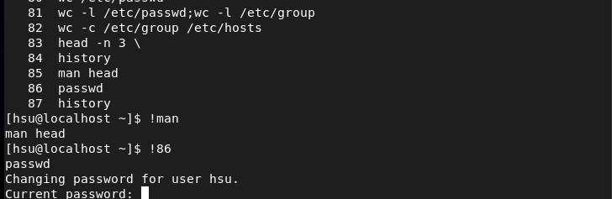
Command History
If you wish to reuse recent command, use !command or line no

Slide 32
Editing the Command Line
The arrow keys can be used to navigate through previous commands in the shell’s history. UpArrow edits the previous command in the history list. DownArrow edits the next command in the history list. LeftArrow and RightArrow move the cursor left and right in the current command from the history list, so that you can edit it before running it
You can use either the Esc+. Or Alt+. Key combination to the insert the last word of the previous command at the cursor’s current location. Repeated use of the key combination will replace that text with the last word of even earlier commands in the history. The Alt+. Key combination is particularly convenient because you can hold down Alt and press. Repeatedly to easily go through earlier and earlier commands

Slide 33
Editing the Command Line
When used interactively, bash has a command-line editing feature. This allows the user to use text editor commands to move around within and modify the current command being typed. Using the arrow keys to move within the current command and to step through the command history was introduced earlier in this session. More powerful editing commands are introduced in the following table.
Shortcut | Descriptions
Ctrl+A | Jump to the beginning of the command line
Ctrl+E | Jump to the end of the command line
Ctrl+U | Clear from the cursor to the beginning of the command line
Ctrl+K | Clear from the cursor to the end of the command line
Ctrl+LeftArrow | Jump to the beginning of the previous word on the command line
Ctrl+RightArrow | Jump to the end of the next word on the command line
Ctrl+R | Search the history list of commands for a pattern

Slide 34
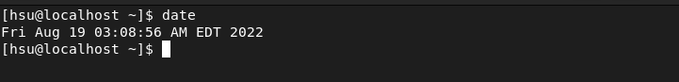
Editing Command Line(Steps)
Use date command to display current date and time
Use +%r command with the date command to display the current time in 12-hour clock time(example, 12:00:00 PM)

Slide 35
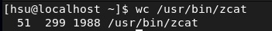
Editing Command Line(Steps)
What kind of file is /usr/bin/zcat? It is readable by human? Use the command line file to determine its file type
The wc command can be used to display the number of lines, words, and bytes in the script /usr/bin/zcat. Instead of retyping the file name, use the Bash history shortcut Esc+.(the keys Esc and . Pressed at the same time) to reuse the argument from the previous command.

Slide 36
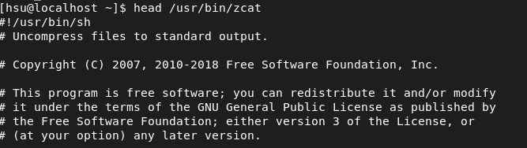
Editing Command Line(Steps)
Use the head command to display the first 10 lines of /usr/bin/zcat. Try using the Esc+. Shortcut again.
The head command to displays the beginning of the file. Did you use the bash shortcut again?

Slide 37
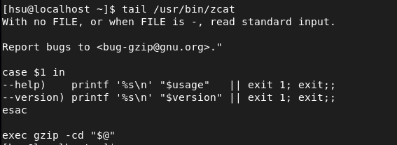
Editing Command Line(Steps)
Display the last 10 lines at the bottom of the /usr/bin/zcat file. Use the tail command.

Slide 38
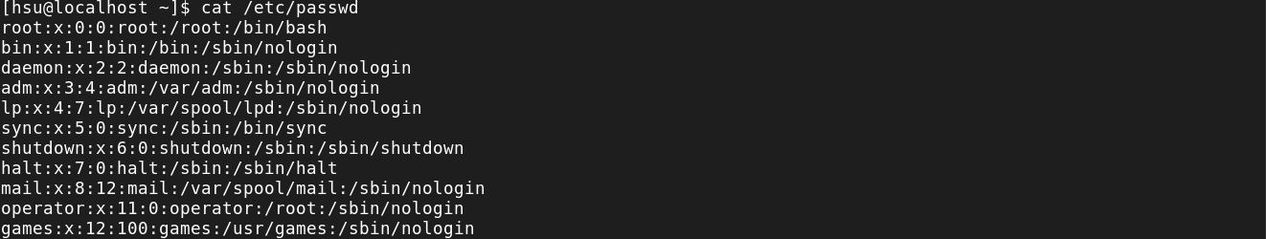
Viewing the Contents of Files
One of the most simple and frequently used commands in Linux is cat. The cat command allows you to create single or multiple files, view the contents of files, concatenate the contents from multiple files, and redirect contents of the file to a terminal or files
The example shows how to view the contents of the /etc/passwd file

Slide 39
Viewing the Contents of Files
Some files are very long and can take up more room to display than that provided by the terminal. The cat command does not display the contents of a file as pages. The less command displays one page of a file at a time and lets you scroll at your leisure
The less command allows you to page forward and backward through files that are longer than can fit on one terminal window. Use the UpArrow key and the DownArrow key to scroll up and down. Press q to exit the command
The head and tail commands display the beginning and end of a file, respectively. By default these commands display 10 lines of the file, but they both have a –n option that allows a different number of lines to be specified. The file to display is passed as an argument to these commands

Slide 40
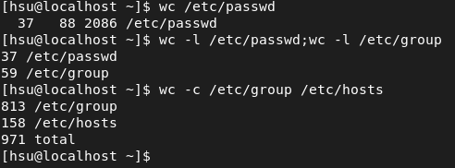
Viewing the Contents of Files
The wc command counts lines, words, and characters in a file. It takes a –l, -w, or –c option to display only the number of lines, words, or characters, respectively

Slide 41
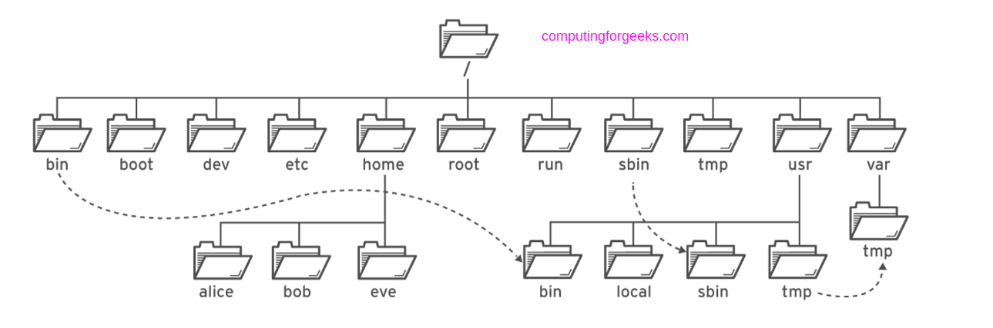
Managing File from command line
All files on a Linux system are stored on file systems, which are organized into a single inverted tree of directories, known as a file-system hierarchy. This tree is inverted because the root of the tree is said to be the top of the hierarchy, and the branches of directories and subdirectories stretch below the root

Slide 42
Managing File from command line
The / directory is the root directory at the top of the file-system hierarchy. The / character is also used as a directory separator in file names. For example, if etc is a subdirectory of the / directory, you could refer to that directory as /etc. Likewise, if the /etc directory contained a file named issue, you could refer to that file as /etc/issue
Subdirectories of / are used for standardized purposes to organize files by type and purpose. This makes it easier to find files. For example, in the root directory, the subdirectory /boot is used for storing files needed to boot the system

Slide 43
Important Red Hat Enterprise Linux Directories
Location | Purpose
/usr | Installed software, shared libraries, include files, and read-only program data. Important subdirectories include: /usr/bin:User commands /usr/sbin:System administration commands /usr/local:Locally customized software
/etc | Configuration files specific to this system
/var | Variable data specific to this system that should persist between boots. Files that dynamically change, such as databases, cache directories, log files, printer-spooled documents, and website content may be found under /var.
/run | Runtime data for processes started since the last boot. This includes process ID files and lock files, among other things. The contents of this directory are recreated on reboot. This directory consolidates /var/run and /var/lock from earlier versions of Red Hat Enterprise Linux.

Slide 44
Important Red Hat Enterprise Linux Directories
Location | Purpose
/var | Variable data specific to this system that should persist between boots. Files that dynamically change, such as database, cache directories, log files, printer-spooled documents, and website content may be found under /var.
/run | Runtime data for processes started since the last boot. This includes process ID files and lock files, among other things. The contents of this directory are recreated on reboot. This directory consolidates /var/run and /var/lock from earlier versions of Red Hat Enterprise Linux.
/home | Home directories are where regular users store their personal data and configuration files.
/root | Home directory for the administrative superuser, root.

Slide 45
Important Red Hat Enterprise Linux Directories
Location | Purpose
/tmp | A world-writable space for temporary files. Files which have not been accessed, changed, or modified for 10 days are deleted from this directory automatically. Another temporary directory exists, /var/tmp, in which files that have not been accessed, changed, or modified in more than 30 days are deleted automatically.
/boot | Files needed in order to start the boot process.
/dev | Contains special device files that are used by the system to access hardware.

Slide 46
Locating file by name

Slide 47
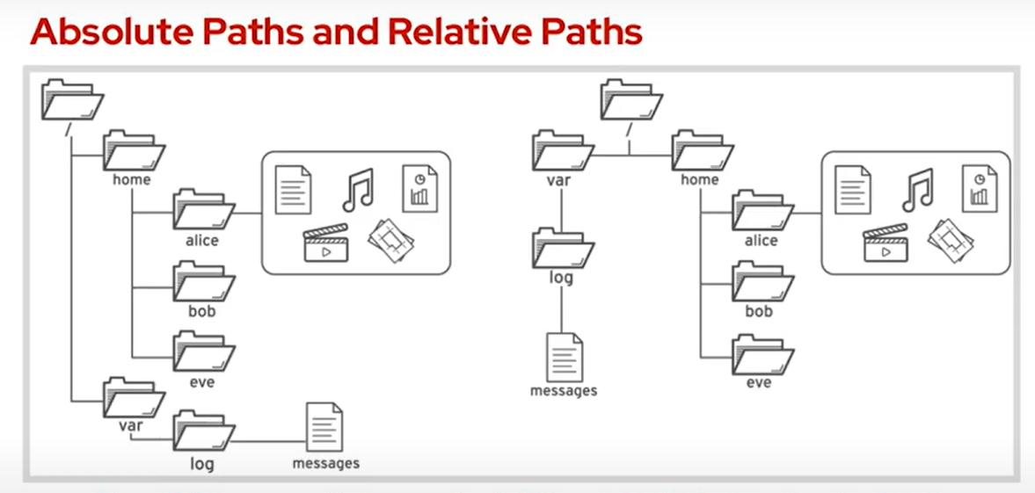
Objective
After completing this section, you should be able to specify the location of files relative to the current working directory and by absolute location, determine and change the working directory, and list the contents of directories.

Slide 48
Absolute Paths and Relative Paths
The path of a file or directory specifies its unique file system location. Following a file path traverses one or more named subdirectories, delimited by a forward slash(/), until the destination is reached. Directories, also called folders, contain other files and other subdirectories. They can be referenced in the same manner as files.

Slide 49
Absolute Paths
A absolute path is a fully qualified name, specifying the files exact location in the file system hierarchy. It begins at the root (/) directory and specifies each subdirectory that must be traversed to reach the specific file. Every file in a file system has a unique absolute path name, recognized with a simple rule: A path name with a forward slash (/) as the first character is an absolute path name. For example, the absolute path name for the system message log file is /var/log/messages. Absolute path names can be long to type, so files may also be located

Slide 50
The Current Working Directory and Relative Paths
When a user logs in and opens a command window, the initial location is normally the user’s home directory. System processes also have an initial directory. Users and processes navigate to other directories as needed; the terms working directory or current working directory refer to their current location.
Like an absolute path, a relative path identifies a unique file, specifying only the path necessary to reach the file from the working directory. Recognizing relative path names follows a simple rule: A path name with anything other than a forward slash as the first character is a relative path name. A user in the /var directory could refer to the message log file relatively as log/messages.

Slide 51
The Current Working Directory and Relative Paths
Linux file systems, including, but not limited to, ext4, XFS, GFS2, and GlusterFS, are case-sensitive. Creating FileCase.txt and filecase.txt in the same directory results in two unique files.
Non-Linux file systems might work differently. For example, VFAT, Microsoft’s NTFS, and Apples HFS+ have case preserving behavior. Although these file systems are not case-sensitive, they do display files in the preceding example on a VFAT file system, both names would be treated as pointing to the same file instead of two different files

Slide 52
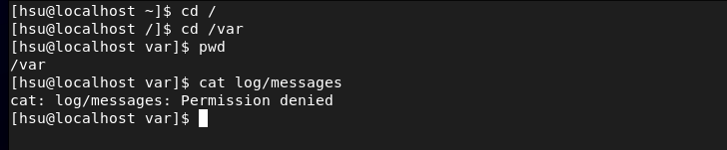
The Current Working Directory and Relative Paths

Slide 53
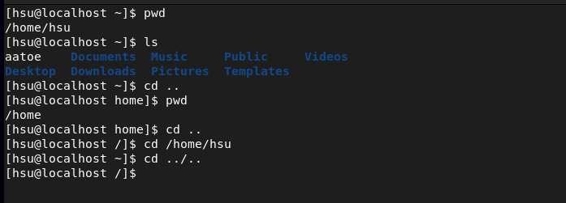
Navigating Paths
The pwd command displays the full path name of the current working directory for that shell. This can help you determine the syntax to reach files using relative path names. The ls command lists directory contents for the specified directory or, if no directory is given, for the current working directory.

Slide 54
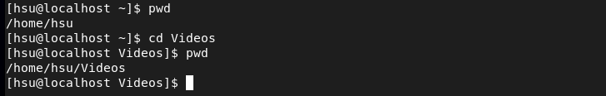
Navigating Paths
Use the cd command to change your shell’s current working directory. If you do not specify any arguments to the command, it will change to your home directory.
In the following example, a mixture of absolute and relative paths are used with cd command to change the current working directory for the shell.

Slide 55
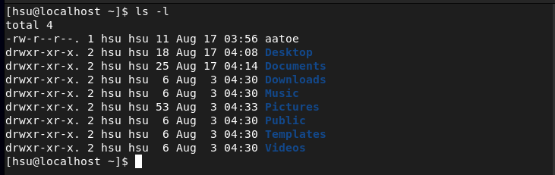
Navigating Paths
The ls command has multiple options for displaying attributes on files. The most common and useful are –l (long listing format), -a(all files, including hidden files), and –R(recursive, to include the contents of all subdirectories).

Slide 56
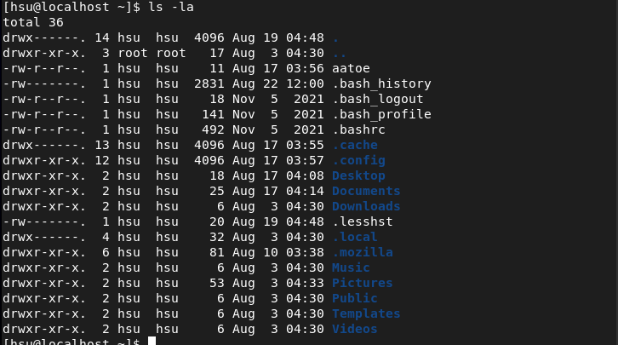
Navigating Paths

Slide 57
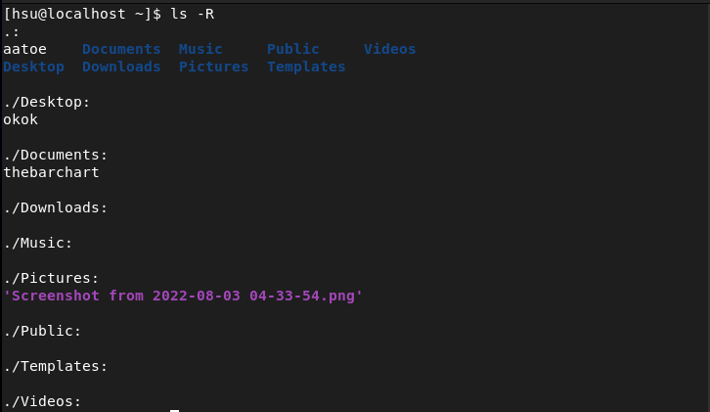
Navigating Paths

Slide 58
Managing Files Using Command-Line Tools

Slide 59
Managing Files Using Command-Line Tools
Objectives
After completing this section, you should be able to create, copy, move, and remove files and directories.
Command-line File Management
To manage files, you need to be able to create, remove, copy, and move them. You also need to organize them logically into directories, which you also need to be able to create, remove, copy and move.

Slide 60
Common file management commands
Activity | Command Syntax
Create a directory | mkdir directory
Copy a file | cp file new-file
Copy a directory and its contents | cp –r directory new-directory
Move or rename a file or directory | mv file new-file
Remove a file | rm file
Remove a directory containing files | rm –r directory
Remove an empty directory | rmdir directory

Slide 61
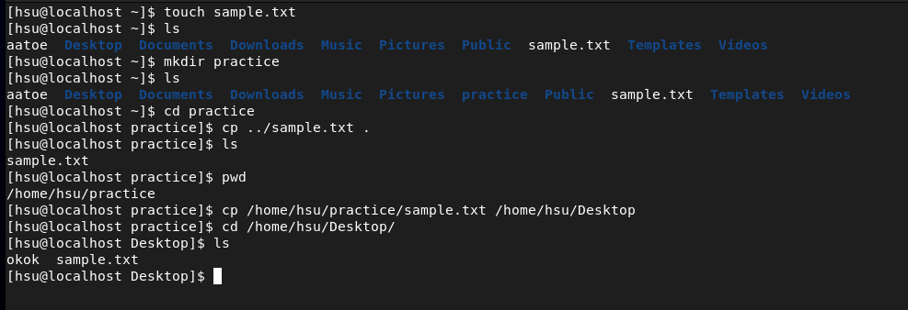
Managing Files Using Command-Line Tools

Slide 62
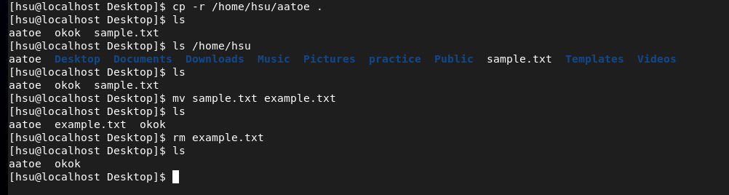
Managing Files Using Command-Line Tools

Slide 63
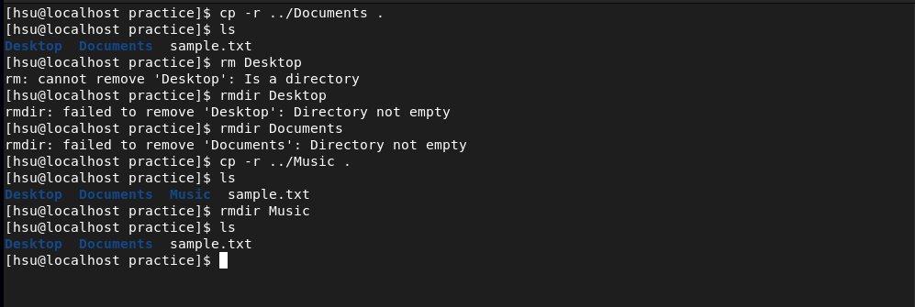
Managing Files Using Command-Line Tools

Slide 64
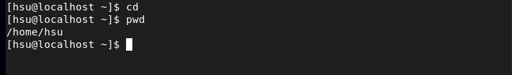
Managing Files Using Command-Line Tools
Make sure you’re in the home directory for your current user by entering the cd command. The pwd command should report /home/hsu. And your shell prompt should show ~.

Slide 65
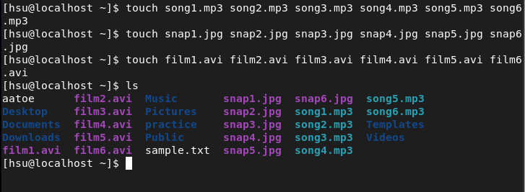
Managing Files Using Command-Line Tools
In the home directory for hsu, create sets of empty practice files to use for the remainder of this lab. In each set, replace X with the numbers 1 through 6.
Create six “song” files with names of the form songX.mp3
Create six “snapshoot” files with names of the form snapX.jpg
Create six “movie” files with names of the form filmX.avi

Slide 66
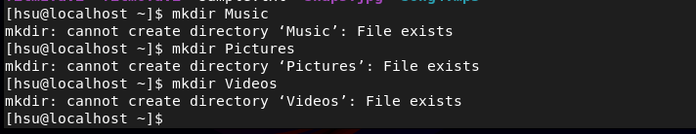
Managing Files Using Command-Line Tools
In the hsu home directory, create three subdirectories, Music, Pictures and Videos.
Node: This is simple user so there always has these if there doesn’t exit, they will create.

Slide 67
Managing Files Using Command-Line Tools
From the hsu home directory, move the song files into the Music subdirectory, the snapshot files into the Pictures subdirectory, and the movie files into the Video subdirectory
Once you are finished, use the ls –l command to the list the contents of each of the subdirectories in order to check you work

Slide 68
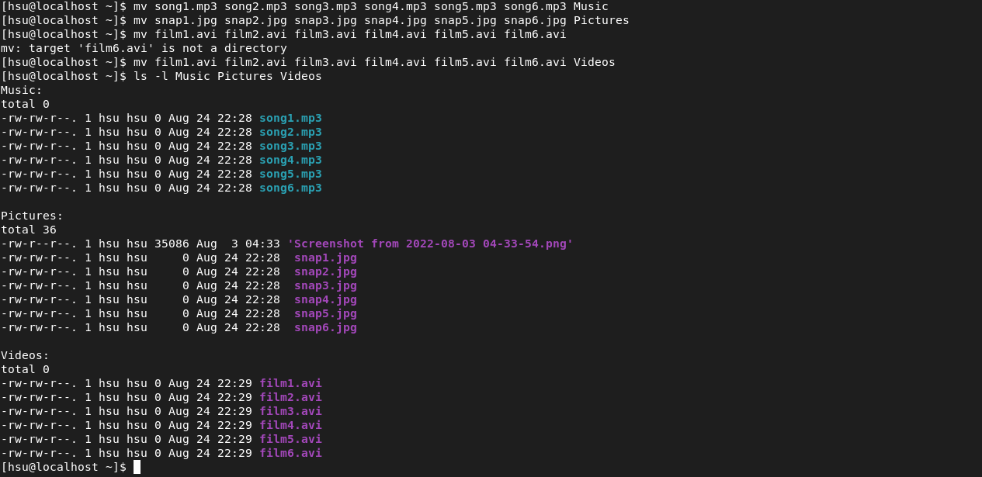
Managing Files Using Command-Line Tools

Slide 69
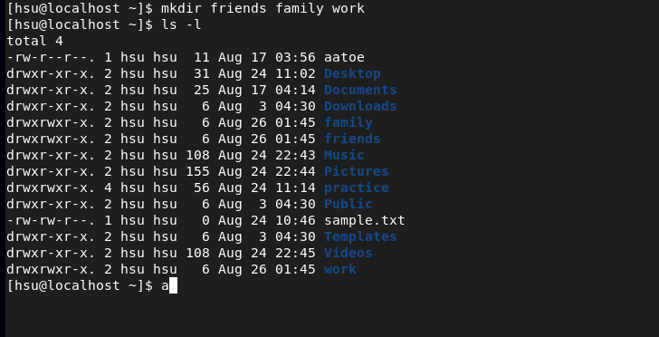
Managing Files Using Command-Line Tools
In the hsu home directory, create three additional subdirectories to organize the files into projects. Call these directories friends, family, and work. Create all three with one command.
Check your work with the ls –l command.

Slide 70
Managing Files Using Command-Line Tools
Next, copy some files from the Music, Pictures, and Videos subdirectories to the friends and family subdirectories.
Copy files in the Music, Pictures, and Videos subdirectories containing numbers 1 and 2 to the friends folder.
Copy files in the Music, Pictures, and Videos subdirectories containing numbers 3 and 4 to the family folder.
Before each copy, the example also changes directory to the destination directory that files are to be copied to. Note that the example uses the special relative directory name . to refer to the shell prompt’s current directory for the copy commands. You may find it quicker to enter commands if you remember that you can use Tab to complete file names quickly. This is not the only possible solution to this step.
Use ls to check your work.

Slide 71
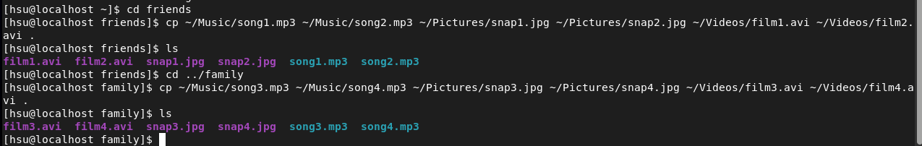
Managing Files Using Command-Line Tools

Slide 72
Managing Files Using Command-Line Tools
Now copy files in the Music, Pictures, and Videos subdirectories containing numbers 5 and 6 to the work subdirectory

Slide 73
Managing Files Using Command-Line Tools
Finally, it’s time to delete the friends, family, and work directories.
Change to the hsu home directory. Attempt to delete both the family and friends directories with a single rmdir command.
Using the rmdir command should fail since both directories have files in them.

Slide 74
Managing Files Using Command-Line Tools
Use the rm command with the –r(recursive) option to delete the family and friends folders and their copies of the files

Slide 75
Managing Files Using Command-Line Tools
Delete all the files in the work subdirectory , but do not delete the work directory itself.

Slide 76
Managing Files Using Command-Line Tools
Finally, form the home directory, use the rmdir command to delete the work directory. The command should succeed now that work is empty.

Slide 77
Matching File Names Using Path Name Expansion

Slide 78
Matching File Names Using Path Name Expansion
Objectives
After completing this section, you should be able to efficiently run commands affecting many files by using pattern matching features of the Bash shell.
Command-line Expansions
The Bash shell has multiple ways of expanding a command line including pattern matching, home directory expansion, string expansion, and variable substitution. Perhaps the most powerful of these is the path name-matching capability, historically called globbing. The Bash globbing feature, sometimes called “wildcards”, makes managing large numbers of files easier. Using metacharacters that “expand” to match file and path names being sought, commands perform on a focused set of files at once.
Pattern Matching
Globbing is a shell command-parsing operation that expands a wildcard pattern into a list of matching path names. Command-line metacharacters are replaced by the match list prior to command execution. Patterns that do not return matches display the original pattern request as literal text. The following are common metacharacters and pattern classes.

Slide 79
Table of Metacharacters and Matches
Pattern | Matches
* | Any string of zero or more characters.
? | Any single character
[abc...] | Any one character in the enclosed class (between the square brackets).
[!abc...] | Any one character not in the enclosed class.
[^abc...] | Any one character not in the enclosed class.
[[:alpha:]] | Any alphabetic character.
[[:lower:]] | Any lowercase character.
[[:upper:]] | Any uppercase character.
[[:alnum:]] | Any alphabetic character or digit.
[[:punct:]] | Any printable character not a space or alphanumeric.
[[:digit:]] | Any single digit from 0 to 9.
[[:space:]] | Any single white space character. This may include tabs, newlines, carriage returns, form feeds, or spaces.

Slide 80
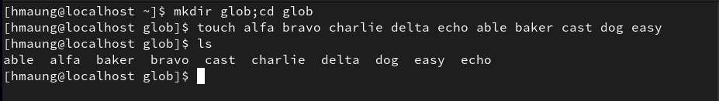
Matching File Names Using Path Name Expansion
For the next few examples, pretend that you have run the following commands to create some sample files

Slide 81
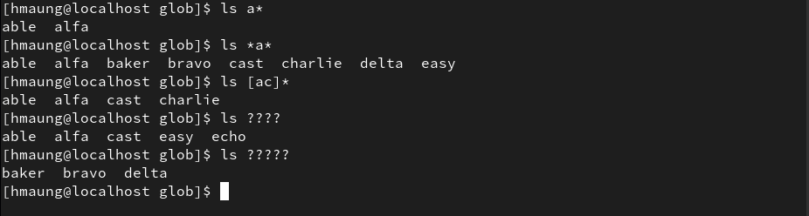
Matching File Names Using Path Name Expansion
The first example will use simple pattern matches with the asterisk (*) and question mark (?) characters, and a class of characters, to match some of those file names.

Slide 82
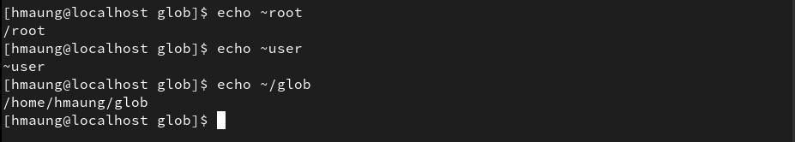
Tilde Expansion
The tilde character (~), matches the current user's home directory. If it starts a string of characters other than a slash (/), the shell will interpret the string up to that slash as a user name, if one matches, and replace the string with the absolute path to that user's home directory. If no user name matches, then an actual tilde followed by the string of characters will be used instead. In the following example the echo command is used to display the value of the tilde character. The echo command can also be used to display the values of brace and variable expansion characters, and others.

Slide 83
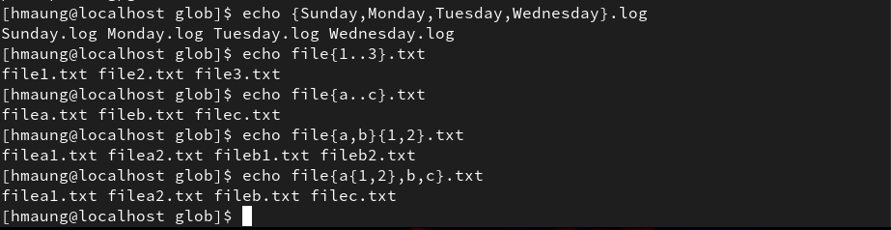
Brace Expansion
Brace expansion is used to generate discretionary strings of characters. Braces contain a commaseparated list of strings, or a sequence expression. The result includes the text preceding or following the brace definition. Brace expansions may be nested, one inside another. Also doubledot syntax (..) expands to a sequence such that {m..p} will expand to m n o p.

Slide 84
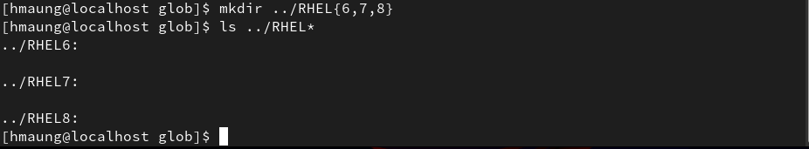
Brace Expansion
A practical use of brace expansion is to quickly create a number of files or directories.

Slide 85
Variable Expansion
A variable acts like a named container that can store a value in memory. Variables make it easy to access and modify the stored data either from the command line or within a shell script.
You can assign data as a value to a variable using the following syntax:
You can use variable expansion to convert the variable name to its value on the command line. If a string starts with a dollar sign ($), then the shell will try to use the rest of that string as a variable name and replace it with whatever value the variable has

Slide 86
Variable Expansion
To help avoid mistakes due to other shell expansions, you can put the name of the variable in curly braces, for example ${VARIABLENAME}.

Slide 87
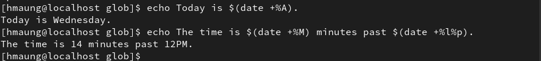
Command Substitution
Command substitution allows the output of a command to replace the command itself on the command line. Command substitution occurs when a command is enclosed in parentheses, and preceded by a dollar sign ($). The $(command) form can nest multiple command expansions inside each other.

Slide 88
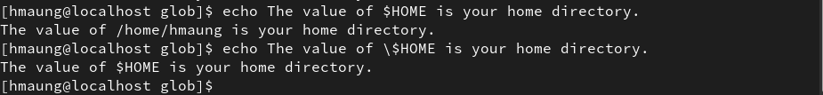
Protecting Arguments from Expansion
Many characters have special meaning in the Bash shell. To keep the shell from performing shell expansions on parts of your command line, you can quote and escape characters and strings.
The backslash (\) is an escape character in the Bash shell. It will protect the character immediately following it from expansion.

Slide 89
Protecting Arguments from Expansion
In the preceding example, protecting the dollar sign from expansion caused Bash to treat it as a regular character and it did not perform variable expansion on $HOME.
To protect longer character strings, single quotes (') or double quotes (") are used to enclose strings. They have slightly different effects. Single quotes stop all shell expansion. Double quotes stop most shell expansion.
Use double quotation marks to suppress globbing and shell expansion, but still allow command and variable substitution.

Slide 90
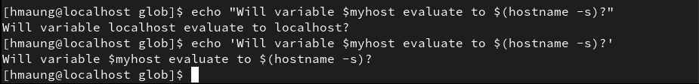
Protecting Arguments from Expansion
Use single quotation marks to interpret all text literally.

Slide 91
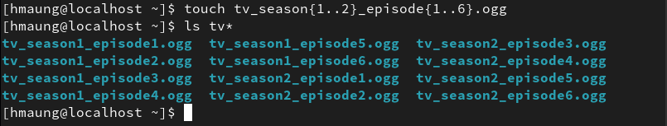
Lab(Step1)
Create an initial set of empty practice files to use in this lab.
This should consist of 12 "recorded video files" with names of the form tv_seasonX_episodeY.ogg. Replace X with the season number (1 or 2). Replace Y with an episode number (1 through 6). This should result in two "seasons" of six "episodes" each.
Use the ls command with a wildcard to check your work by listing all the files with names that start with tv.

Slide 92
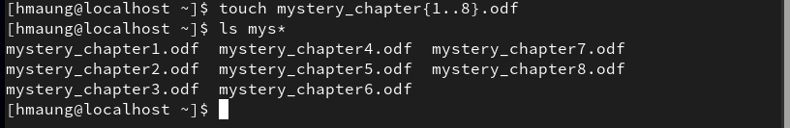
Lab(Step2)
As the author of a successful series of mystery novels, your next bestseller's chapters are being edited for publishing. Create a total of eight files with names mystery_chapterX.odf. Replace X with the numbers 1 through 8. Check your work by listing all the files with names that start with mys.

Slide 93
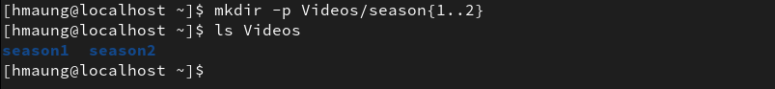
Lab(Step3)
From the home directory, create two subdirectories named season1 and season2 under the Videos directory. Use one command. (Hint: if Videos does not exist from an earlier exercise, the -p option for mkdir will create any missing parent directories if necessary.)

Slide 94
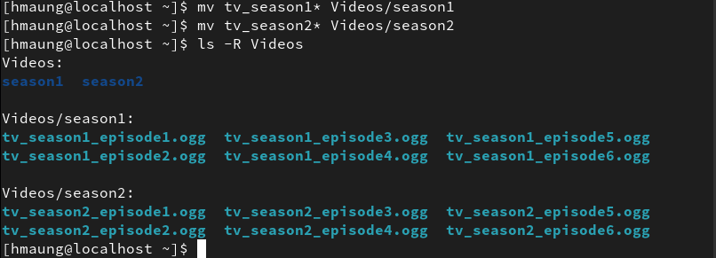
Lab(Step4)
Move the appropriate tv_seasonX_episodeY.ogg files into the season1 and season2 subdirectories. Use only two commands, specifying destinations using relative paths.

Slide 95
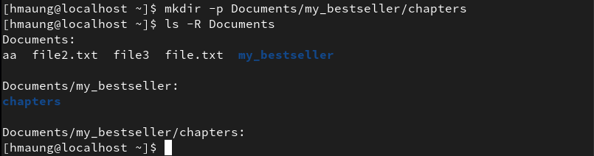
Lab(Step5)
To organize the mystery book chapters, create a two-level directory hierarchy with one command. Create the directory my_bestseller under the Documents directory, and the directory chapters beneath the new my_bestseller directory.

Slide 96

Lab(Step6)
Using one command, create three more subdirectories directly under the my_bestseller directory. Name these subdirectories editor, changes, and vacation. The create parent (-p) option is not needed since the my_bestseller parent directory already exists.

Slide 97

Lab(Step7)
Change to the chapters directory. Using the tilde (~) home directory shortcut to specify the source files, move all book chapters into the chapters directory, which is now your current directory. What is the simplest syntax to specify the destination directory?

Slide 98

Lab(Step8)
The first two chapters are sent to the editor for review. To remember to not modify these chapters during the review, move those two chapters only to the editor directory. Starting from the chapters subdirectory, use brace expansion with a range to specify the chapter file names to copy and a relative path for the destination directory.

Slide 99

Lab(Step9)
Chapters 7 and 8 will be written while on vacation. Move the files from chapters to vacation. Use one command, specifying the chapter file names using brace expansion with a list of strings and without using wildcard characters.

Slide 100
Lab(Step10)
Change your working directory to ~/Videos/season2, then copy the first episode of the season to the vacation directory.

Slide 101

Lab(Step11)
With one cd command, change your working directory to ~/Documents/my_bestseller/ vacation. List its files. Return to the season2 directory using cd with its previous working directory argument. (This will succeed if the last directory change with cd was accomplished with one command rather than several cd commands.) Copy the episode 2 file into vacation. Return to vacation using the cd shortcut again.

Slide 102

Lab(Step12)
Chapters 5 and 6 may need a plot change. To prevent these changes from modifying original files, copy both files into changes. Move up one directory to the parent directory of vacation, then use one command from there. Try using square bracket pattern matching to specify which chapter numbers to match in the file name with the copy command.

Slide 103

Lab(Step13)
Change your current directory to the changes directory. Use the date +%F command with command substitution to copy mystery_chapter5.odf to a new file name which includes the full date. The name should have the form mystery_chapter5_YYYY-MM-DD.odf. Make another copy of mystery_chapter5.odf, appending the current timestamp (as the number of seconds since the epoch, 1970-01-01 00:00 UTC) to ensure a unique file name. Use command substitution with the date +%s command to accomplish this.

Slide 104

Lab(Step14)
Delete the changes directory in the following way. First, delete all of the files in the changes directory. The current working directory should be changes at this point. Change to its parent directory, because a directory cannot be deleted while it is the current working directory. Try to delete the empty directory using the rm command without the recursive option. This attempt should fail. (If you had used the option, it would succeed.) Finally, use the rmdir command to delete the empty directory, which will succeed.

Slide 105

Lab(Step15)
When the vacation is over, the vacation directory is no longer needed. Delete it using the rm command with the recursive option.

Slide 106
Editing Text Files from the Shell Prompt

Slide 107
Editing Text Files from the Shell Prompt
Objectives
After completing this section, you should be able to create and edit text files from the command line using the vim editor.
Editing Files with Vim
A key design principle of Linux is that information and configuration settings are commonly stored in text-based files. These files can be structured in various ways, as lists of settings, in INI-like formats, as structured XML or YAML, and so on. However, the advantage of text files is that they can be viewed and edited using any simple text editor.
Vim is an improved version of the vi editor distributed with Linux and UNIX systems. Vim is highly configurable and efficient for practiced users, including such features as split screen editing, color formatting, and highlighting for editing text.

Slide 108
Why Learn Vim?
You should know how to use at least one text editor that can be used from a text-only shell prompt. If you do, you can edit text-based configuration files from a terminal window, or from remote logins through ssh or the Web Console. Then you do not need access to a graphical desktop in order to edit files on a server, and in fact that server might not need to run a graphical desktop environment at all.
But then, why learn Vim instead of other possible options? The key reason is that Vim is almost always installed on a server, if any text editor is present. This is because vi was specified by the POSIX standard that Linux and many other UNIX-like operating systems comply with in large part.
In addition, Vim is often used as the vi implementation on other common operating systems or distributions. For example, macOS currently includes a lightweight installation of Vim by default. So Vim skills learned for Linux might also help you get things done elsewhere.

Slide 109
Starting Vim
Vim may be installed in Red Hat Enterprise Linux in two different ways. This can affect the features and Vim commands available to you.
Your server might only have the vim-minimal package installed. This is a very lightweight installation that includes only the core feature set and the basic vi command. In this case, you can open a file for editing with vi filename, and all the core features discussed in this section will be available to you.
Alternatively, your server might have the vim-enhanced package installed. This provides a much more comprehensive set of features, an on-line help system, and a tutorial program. In order to start Vim in this enhanced mode, you use the vim command.
[user@host ~]$ vim filename

Slide 110

Vim Operating Modes
An unusual characteristic of Vim is that it has several modes of operation, including command mode, extended command mode, edit mode, and visual mode. Depending on the mode, you may be issuing commands, editing text, or working with blocks of text. As a new Vim user, you should always be aware of your current mode as keystrokes have different effects in different modes.

Slide 111

Vim Operating Modes
Figure. Moving between Vim modes

Slide 112
Vim Operating Modes
When you first open Vim, it starts in command mode, which is used for navigation, cut and paste, and other text manipulation. Enter each of the other modes with single character keystrokes to access specific editing functionality:
An i keystroke enters insert mode, where all text typed becomes file content. Pressing Esc returns to command mode.
A v keystroke enters visual mode, where multiple characters may be selected for text manipulation. Use Shift+V for multiline and Ctrl+V for block selection. The same keystroke used to enter visual mode (v, Shift+V or Ctrl+V) is used to exit.
The : keystroke begins extended command mode for tasks such as writing the file (to save it), and quitting the Vim editor.

Slide 113
The Minimum, Basic Vim Workflow
Vim has efficient, coordinated keystrokes for advanced editing tasks. Although considered useful with practice, Vim's capabilities can overwhelm new users.
The i key puts Vim into insert mode. All text entered after this is treated as file contents until you exit insert mode. The Esc key exits insert mode and returns Vim to command mode. The u key will undo the most recent edit. Press the x key to delete a single character. The :w command writes (saves) the file and remains in command mode for more editing. The :wq command writes (saves) the file and quits Vim. The :q! command quits Vim, discarding all file changes since the last write. The Vim user must learn these commands to accomplish any editing task.

Slide 114
Rearranging Existing Text
In Vim, copy and paste is known as yank and put, using command characters y and p.
Begin by positioning the cursor on the first character to be selected, and then enter visual mode.
Use the arrow keys to expand the visual selection.
When ready, press y to yank the selection into memory.
Position the cursor at the new location, and then press p to put the selection at the cursor.

Slide 115
Visual Mode in Vim
Visual mode is a great way to highlight and manipulate text. There are three keystrokes:
Character mode: v
Line mode: Shift+v
Block mode: Ctrl+v
Character mode highlights sentences in a block of text. The word VISUAL will appear at the bottom of the screen. Press v to enter visual character mode. Shift+v enters line mode. VISUAL LINE will appear at the bottom of the screen.
Visual block mode is perfect for manipulating data files. From the cursor, press the Ctrl+v to enter visual block. VISUAL BLOCK will appear at the bottom of the screen. Use the arrow keys to highlight the section to change.

Slide 116
Managing Local Linux Users and Groups

Slide 117
Users and Groups
Objectives
After completing this section, you should be able to describe the purpose of users and groups on a Linux system.
What is a User?
A user account is used to provide security boundaries between different people and programs that can run commands. Users have user names to identify them to human users and make them easier to work with. Internally, the system distinguishes user accounts by the unique identification number assigned to them, the user ID or UID. If a user account is used by humans, it will generally be assigned a secret password that the user will use to prove that they are the actual authorized user when logging in.

Slide 118
What is a User?
User accounts are fundamental to system security. Every process (running program) on the system runs as a particular user. Every file has a particular user as its owner. File ownership helps the system enforce access control for users of the files. The user associated with a running process determines the files and directories accessible to that process.
There are three main types of user account: the superuser, system users, and regular users.
The superuser account is for administration of the system. The name of the superuser is root and the account has UID 0. The superuser has full access to the system.
The system has system user accounts which are used by processes that provide supporting services. These processes, or daemons, usually do not need to run as the superuser. They are assiged non-privileged accounts that allow them to secure their files and other resources from each other and from regular users on the system. Users do not interactively log in using a system user account.

Slide 119

What is a User?
Most users have regular user accounts which they use for their day-to-day work. Like system users, regular users have limited access to the system.
You can use the id command to show information about the currently logged-in user.

Slide 120
What is a User?
To view basic information about another user, pass the username to the id command as an argument
To view the owner of a file use the ls -l command. To view the owner of a directory use the ls -ld command. In the following output, the third column shows the username.
[user01@host]$ id user02
uid=1002(user02) gid=1001(user02) groups=1001(user02) context=unconfined_u:unconfined_r:unconfined_t:s0-s0:c0.c1023
[user01@host ~]$ ls -l file1
-rw-rw-r--. 1 user01 user01 0 Feb 5 11:10 file1
[user01@host]$ ls -ld dir1
drwxrwxr-x. 2 user01 user01 6 Feb 5 11:10 dir1

Slide 121

What is a User?
To view process information, use the ps command. The default is to show only processes in the current shell. Add the a option to view all processes with a terminal. To view the user associated with a process, include the u option. In the following output, the first column shows the username.

Slide 122
What is a User?
The output of the preceding command displays users by name, but internally the operating system uses the UIDs to track users. The mapping of usernames to UIDs is defined in databases of account information. By default, systems use the /etc/passwd file to store information about local users. Each line in the /etc/passwd file contains information about one user. It is divided up into seven colon-separated fields. Here is an example of a line from /etc/passwd:
user01: x: 1000: 1000: User One: /home/user01: /bin/bash

Slide 123
What is a User?
Username for this user (user01).
The user's password used to be stored here in encrypted format. That has been moved to the /etc/shadow file, which will be covered later. This field should always be x.
The UID number for this user account (1000).
The GID number for this user account's primary group (1000). Groups will be discussed later in this section.
The real name for this user (User One).
The home directory for this user (/home/user01). This is the initial working directory when the shell starts and contains the user's data and configuration settings.
The default shell program for this user, which runs on login (/bin/bash). For a regular user, this is normally the program that provides the user's command-line prompt. A system user might use /sbin/nologin if interactive logins are not allowed for that user.

Slide 124
What is a Group?
A group is a collection of users that need to share access to files and other system resources. Groups can be used to grant access to files to a set of users instead of just a single user.
Like users, groups have group names to make them easier to work with. Internally, the system distinguishes groups by the unique identification number assigned to them, the group ID or GID.
The mapping of group names to GIDs is defined in databases of group account information. By default, systems use the /etc/group file to store information about local groups.

Slide 125
What is a Group?
Each line in the /etc/group file contains information about one group. Each group entry is divided into four colon-separated fields. Here is an example of a line from /etc/group:
group01: x: 10000: user01,user02,user03
Group name for this group (group01).
Obsolete group password field. This field should always be x.
The GID number for this group (10000).
A list of users who are members of this group as a supplementary group (user01, user02, user03). Primary (or default) and supplementary groups are discussed later in this section.

Slide 126
Primary Groups and Supplementary Groups
Every user has exactly one primary group. For local users, this is the group listed by GID number in the /etc/passwd file. By default, this is the group that will own new files created by the user.
Normally, when you create a new regular user, a new group with the same name as that user is created. That group is used as the primary group for the new user, and that user is the only member of this User Private Group. It turns out that this helps make management of file permissions simpler, which will be discussed later in this course.
Users may also have supplementary groups. Membership in supplementary groups is determined by the /etc/group file. Users are granted access to files based on whether any of their groups have access. It doesn't matter if the group or groups that have access are primary or supplementary for the user.
For example, if the user user01 has a primary group user01 and supplementary groups wheel and webadmin, then that user can read files readable by any of those three groups.
The id command can also be used to find out about group membership for a user.

Slide 127
Primary Groups and Supplementary Groups
[user03@host ~]$ id
uid=1003(user03) gid=1003(user03) groups=1003(user03),10(wheel),10000(group01) context=unconfined_u:unconfined_r:unconfined_t:s0-s0:c0.c1023
In the preceding example, user03 has the group user03 as their primary group (gid). The groups item lists all groups for this user, and other than the primary group user03, the user has groups wheel and group01 as supplementary groups.

Slide 128
Gaining Superuser Access

Slide 129
Gaining Superuser Access
Objectives
After completing this section, you will be able to switch to the superuser account to manage a Linux system, and grant other users superuser access through the sudo command.
The Superuser
Most operating systems have some sort of superuser, a user that has all power over the system. In Red Hat Enterprise Linux this is the root user. This user has the power to override normal privileges on the file system, and is used to manage and administer the system. To perform tasks such as installing or removing software and to manage system files and directories, users must escalate their privileges to the root user.

Slide 130
The Superuser
The root user only among normal users can control most devices, but there are a few exceptions. For example, normal users can control removable devices, such as USB devices. Thus, normal users can add and remove files and otherwise manage a removable device, but only root can manage "fixed" hard drives by default.
This unlimited privilege, however, comes with responsibility. The root user has unlimited power to damage the system: remove files and directories, remove user accounts, add back doors, and so on. If the root user's account is compromised, someone else would have administrative control of the system. Throughout this course, administrators are encouraged to log in as a normal user and escalate privileges to root only when needed.
The root account on Linux is roughly equivalent to the local Administrator account on Microsoft Windows. In Linux, most system administrators log in to the system as an unprivileged user and use various tools to temporarily gain root privileges.

Slide 131
Switching Users
The su command allows users to switch to a different user account. If you run su from a regular user account, you will be prompted for the password of the account to which you want to switch. When root runs su, you do not need to enter the user's password.
If you omit the user name, the su or su - command attempts to switch to root by default.
[user01@host ~]$ su - user02
Password:
[user02@host ~]$
[user01@host ~]$ su –
Password:
[root@host ~]#

Slide 132
Switching Users
The command su starts a non-login shell, while the command su - (with the dash option) starts a login shell. The main distinction between the two commands is that su - sets up the shell environment as if it were a new login as that user, while su just starts a shell as that user, but uses the original user's environment settings.
In most cases, administrators should run su - to get a shell with the target user's normal environment settings. For more information, see the bash(1) man page.

Slide 133
Running Commands with Sudo
In some cases, the root user's account may not have a valid password at all for security reasons. In this case, users cannot log in to the system as root directly with a password, and su cannot be used to get an interactive shell. One tool that can be used to get root access in this case is sudo.
Unlike su, sudo normally requires users to enter their own password for authentication, not the password of the user account they are trying to access. That is, users who use sudo to run commands as root do not need to know the root password. Instead, they use their own passwords to authenticate access.
Additionally, sudo can be configured to allow specific users to run any command as some other user, or only some commands as that user.

Slide 134
Running Commands with Sudo
For example, when sudo is configured to allow the user01 user to run the command usermod as root, user01 could run the following command to lock or unlock a user account:
[user01@host ~]$ sudo usermod -L user02 [sudo] password for user01:
[user01@host ~]$ su - user02
Password:
su: Authentication failure
[user01@host ~]$

Slide 135
Running Commands with Sudo
If a user tries to run a command as another user, and the sudo configuration does not permit it, the command will be blocked, the attempt will be logged, and by default an email will be sent to the root user.
One additional benefit to using sudo is that all commands executed are logged by default to / var/log/secure.
[user02@host ~]$ sudo tail /var/log/secure
[sudo] password for user02:
user02 is not in the sudoers file. This incident will be reported.
[user02@host ~]$
[user01@host ~]$ sudo tail /var/log/secure
...output omitted...
Feb 6 20:45:46 host sudo[2577]: user01 : TTY=pts/0 ; PWD=/home/user01 ; USER=root ; COMMAND=/sbin/usermod -L user02
...output omitted...

Slide 136
Running Commands with Sudo
In Red Hat Enterprise Linux 7 and Red Hat Enterprise Linux 8, all members of the wheel group can use sudo to run commands as any user, including root. The user is prompted for their own password. This is a change from Red Hat Enterprise Linux 6 and earlier, where users who were members of the wheel group did not get this administrative access by default.

Slide 137
Getting an Interactive Root Shell with Sudo
If there is a nonadministrative user account on the system that can use sudo to run the su command, you can run sudo su - from that account to get an interactive root user shell. This works because sudo will run su - as root, and root does not need to enter a password to use su.
Another way to access the root account with sudo is to use the sudo -i command. This will switch to the root account and run that user's default shell (usually bash) and associated shell login scripts. If you just want to run the shell, you can use the sudo -s command.
For example, an administrator might get an interactive shell as root on an AWS EC2 instance by using SSH public-key authentication to log in as the normal user ec2-user, and then by running sudo -i to get the root user's shell.

Slide 138
Getting an Interactive Root Shell with Sudo
The sudo su - command and sudo -i do not behave exactly the same. This will be discussed briefly at the end of the section.
[ec2-user@host ~]$ sudo -i
[sudo] password for ec2-user:
[root@host ~]#

Slide 139


Lab (Step1)
Explore the characteristics of the user shell environment.
View the current user and group information and display the current working directory.
View the environment variables which specify the user's home directory and the locations searched for executable files.

Slide 140

Lab (Step2)
Switch to root by using sudo to run su without the dash, and explore the characteristics of the new shell environment.
Become the root user at the shell prompt.

Slide 141


Lab (Step2)
View the current user and group information and display the current working directory. Note that the user identity changed, but not the current working directory.
View the environment variables which specify the home directory and the locations searched for executable files. Look for references to the user and root accounts.

Slide 142
Lab (Step2)
Exit the shell to return to the user user

Slide 143
Lab (Step3)
Switch to root by using sudo to run su -, and compare the characteristics of the new shell environment with those of the preceding example.
Become the root user at the shell prompt. Be sure all the login scripts are also executed.

Slide 144

Lab (Step3)
View the current user and group information and display the current working directory.
View the environment variables which specify the home directory and the locations searched for executable files. Look for references to the user and root accounts.

Slide 145

Lab (Step3)
Exit the root shell to return to the user shell.

Slide 146

Lab (Step4)
Next, run several commands as user which require root access. Then, rather than using sudo su - to run them as root from an interactive root shell, use sudo to run those commands as root from the user shell as one-off commands.
View the last 5 lines of the /var/log/messages. Your output may vary from this example.

Slide 147


Lab (Step4)
Make a backup of a configuration file in the /etc directory.
Remove the /etc/issueOLD file that was just created.

Slide 148
Managing Local User Accounts

Slide 149
Managing Local User Accounts
Objectives
After completing this section, you should be able to create, modify, and delete local user accounts.
Managing Local Users
A number of command-line tools can be used to manage local user accounts.
Creating Users from the Command Line
The useradd username command creates a new user named username. It sets up the user's home directory and account information, and creates a private group for the user named username. At this point the account does not have a valid password set, and the user cannot log in until a password is set.

Slide 150
Managing Local Users
The useradd --help command displays the basic options that can be used to override the defaults. In most cases, the same options can be used with the usermod command to modify an existing user.
Some defaults, such as the range of valid UID numbers and default password aging rules, are read from the /etc/login.defs file. Values in this file are only used when creating new users. A change to this file does not affect existing users.
Modifying Existing Users from the Command Line
The usermod --help command displays the basic options that can be used to modify an account. Some common options include:

Slide 151
Modifying Existing Users from the Command Line
usermod options: | Usage
-c, --comment COMMENT | Add the user's real name to the comment field.
-g, --gid GROUP | Specify the primary group for the user account.
-G, --groups GROUPS | Specify a comma-separated list of supplementary groups for the user account.
-a, --append | Used with the -G option to add the supplementary groups to the user's current set of group memberships instead of replacing the set of supplementary groups with a new set.
-d, --home HOME_DIR | Specify a particular home directory for the user account.
-m, --move-home | Move the user's home directory to a new location. Must be used with the -d option.
-s, --shell SHELL | Specify a particular login shell for the user account.
-L, --lock | Lock the user account.
-U, --unlock | Unlock the user account.

Slide 152
Deleting Users from the Command Line
The userdel username command removes the details of username from /etc/passwd, but leaves the user's home directory intact.
The userdel -r username command removes the details of username from /etc/passwd and also deletes the user's home directory
Deleting Users from the Command Line(Warning)
When a user is removed with userdel without the -r option specified, the system will have files that are owned by an unassigned UID. This can also happen when a file, having a deleted user as its owner, exists outside that user's home directory. This situation can lead to information leakage and other security issues.
In Red Hat Enterprise Linux 7 and Red Hat Enterprise Linux 8, the useradd command assigns new users the first free UID greater than or equal to 1000, unless you explicitly specify one using the -u option.

Slide 153
Deleting Users from the Command Line(Warning)
This is how information leakage can occur. If the first free UID had been previously assigned to a user account which has since been removed from the system, the old user's UID will get reassigned to the new user, giving the new user ownership of the old user's remaining files.
The following scenario demonstrates this situation.
[root@host ~]# useradd user01
[root@host ~]# ls -l /home
drwx------. 3 user01 user01 74 Feb 4 15:22 user01
[root@host ~]# userdel user01
[root@host ~]# ls -l /home
drwx------. 3 1000 1000 74 Feb 4 15:22 user01
[root@host ~]# useradd user02
[root@host ~]# ls -l /home
drwx------. 3 user02 user02 74 Feb 4 15:23 user02
drwx------. 3 user02 user02 74 Feb 4 15:22 user01

Slide 154
Deleting Users from the Command Line(Warning)
Notice that user02 now owns all files that user01 previously owned.
Depending on the situation, one solution to this problem is to remove all unowned files from the system when the user that created them is deleted. Another solution is to manually assign the unowned files to a different user. The root user can use the find / -nouser -o -nogroup command to find all unowned files and directories.

Slide 155
Setting Passwords from the Command Line
The passwd username command sets the initial password or changes the existing password of username.
The root user can set a password to any value. A message is displayed if the password does not meet the minimum recommended criteria, but is followed by a prompt to retype the new password and all tokens are updated successfully
A regular user must choose a password at least eight characters long and is also not based on a dictionary word, the username, or the previous password.
[root@host ~]# passwd user01
Changing password for user user01.
New password: redhat
BAD PASSWORD: The password fails the dictionary check - it is based on a dictionary word
Retype new password: redhat
passwd: all authentication tokens updated successfully.
[root@host ~]#

Slide 156
UID Ranges
Specific UID numbers and ranges of numbers are used for specific purposes by Red Hat Enterprise Linux.
UID 0 is always assigned to the superuser account, root.
UID 1-200 is a range of "system users" assigned statically to system processes by Red Hat.
UID 201-999 is a range of "system users" used by system processes that do not own files on the file system. They are typically assigned dynamically from the available pool when the software that needs them is installed. Programs run as these "unprivileged" system users in order to limit their access to only the resources they need to function.
UID 1000+ is the range available for assignment to regular users.

Slide 157

Lab(Step 1 && 2 && 3)
Become the root user at the shell prompt.
Add the user juliet.
Confirm that juliet has been added by examining the /etc/passwd file.

Slide 158

Lab(Step 4)
Use the passwd command to initialize juliet's password. For this and any other passwords you set in this section, the values are not important but should be "secure". Be careful, the root user can set arbitrarily weak passwords!
The example below assumes you typed something (the same thing!) for the New password and Retype new password prompts.

Slide 159

Lab(Step 5)
Continue adding the remaining users in the steps below and set initial passwords. These users will be used in the next exercise.
Romeo

Slide 160
Lab(Step 5)
hamlet
sunni
huong
jerlene

Slide 161
Managing Local Group Accounts

Slide 162
Managing Local Group Accounts
Objectives
After completing this section, students should be able to create, modify, and delete local group accounts.
Managing Local Groups
A group must exist before a user can be added to that group. Several command-line tools are used to manage local group accounts.
Creating Groups from the Command Line
The groupadd command creates groups. Without options the groupadd command uses the next available GID from the range specified in the /etc/login.defs file while creating the groups.

Slide 163
Creating Groups from the Command Line
The -g option specifies a particular GID for the group to use.
The -r option creates a system group using a GID from the range of valid system GIDs listed in the /etc/login.defs file. The SYS_GID_MIN and SYS_GID_MAX configuration items in / etc/login.defs define the range of system GIDs.
[user01@host ~]$ sudo groupadd -g 10000 group01 [user01@host ~]$ tail /etc/group
...output omitted...
group01:x:10000:
[user01@host ~]$ sudo groupadd -r group02 [user01@host ~]$ tail /etc/group
...output omitted...
group01:x:10000:
group02:x:988:

Slide 164
Modifying Existing Groups from the Command Line
The groupmod command changes the properties of an existing group. The -n option specifies a new name for the group.
Notice that the group name is updated to group0022 from group02.
The -g option specifies a new GID.
Notice that the GID is updated to 20000 from 988.
[user01@host ~]$ sudo groupmod -n group0022 group02 [user01@host ~]$ tail /etc/group
...output omitted...
group0022:x:988:
[user01@host ~]$ sudo groupmod -g 20000 group0022 [user01@host ~]$ tail /etc/group
...output omitted...
group0022:x:20000:

Slide 165
Deleting Groups from the Command Line
The groupdel command removes groups.
Changing Group Membership from the Command Line
The membership of a group is controlled with user management. Use the usermod -g command to change a user's primary group
[user01@host ~]$ sudo groupdel group0022
[user01@host ~]$ id user02
uid=1006(user02) gid=1008(user02) groups=1008(user02)
[user01@host ~]$ sudo usermod -g group01 user02
[user01@host ~]$ id user02
uid=1006(user02) gid=10000(group01) groups=10000(group01)

Slide 166
Changing Group Membership from the Command Line
Use the usermod -aG command to add a user to a supplementary group.
[user01@host ~]$ id user03
uid=1007(user03) gid=1009(user03) groups=1009(user03)
[user01@host ~]$ sudo usermod -aG group01 user03
[user01@host ~]$ id user03
uid=1007(user03) gid=1009(user03) groups=1009(user03),10000(group01)

Slide 167
Lab(Step 1)
Become the root user at the shell prompt.
Create a supplementary group called shakespeare with a group ID of 30000.
Create a supplementary group called artists.

Slide 168

Lab(Step 2)
Confirm that shakespeare and artists have been added by examining the /etc/ group file.
Add the juliet user to the shakespeare group as a supplementary group.

Slide 169
Lab(Step 3)
Confirm that juliet has been added using the id command.
Continue adding the remaining users to groups as follows:
Add romeo and hamlet to the shakespeare group.
Add sunni, huong, and jerlene to the artists group.

Slide 170

Lab(Step 4)
Verify the supplemental group memberships by examining the /etc/group file.

Slide 171


Lab 2 (Step 1)
Create a new group named consultants with a GID of 40000.
Create three new users: djonasen, salves, and dtyson, set a password for each, and add each to the supplementary group consultants. Each user's primary group should be a user private group with the same name as the user.

Slide 172

Lab 2 (Step 2)

Slide 173

Lab 2 (Step 2)
Check each user to confirm the account exists and has the correct group memberships. The exact UID numbers may differ for your solution, but the names of the users and groups should be correct, and consultants should have GID 40000.

Slide 174
Controlling Access to Files with Linux File System Permissions

Slide 175
Linux File System Permissions
Objectives
After completing this section, you should be able to list file-system permissions on files and directories, and interpret the effect of those permissions on access by users and groups.
Linux File-system Permissions
File permissions control access to files. Linux file permissions are simple but flexible, easy to understand and apply, yet still able to handle most normal permission cases easily.
Files have three user categories to which permissions apply. The file is owned by a user, normally the one who created the file. The file is also owned by a single group, usually the primary group of the user who created the file, but this can be changed. Different permissions can be set for the owning user, the owning group, and for all other users on the system that are not the user or a member of the owning group.

Slide 176

Linux File-system Permissions
The most specific permissions take precedence. User permissions override group permissions, which override other permissions.
In Figure, joshua is a member of the groups joshua and web, and allison is a member of allison, wheel, and web. When joshua and allison need to collaborate, the files should be associated with the group web and group permissions should allow the desired access.
Figure : Example group membership to facilitate collaboration

Slide 177
Linux File-system Permissions
Three permission categories apply: read, write, and execute. The following table explains how these permissions affect access to files and directories.
Effects of Permissions on Files and Directories
Permission | Effect on files | Effect on directories
r (read) | File contents can be read. | Contents of the directory (the file names) can be listed.
w (write) | File contents can be changed. | Any file in the directory can be created or deleted.
x (execute) | Files can be executed as commands. | The directory can become the current working directory. (You can cd into it, but also require read permission to list files found there.)

Slide 178
Linux File-system Permissions
Users normally have both read and execute permissions on read-only directories so that they can list the directory and have full read-only access to its contents. If a user only has read access on a directory, the names of the files in it can be listed, but no other information, including permissions or time stamps, are available, nor can they be accessed. If a user only has execute access on a directory, they cannot list file names in the directory. If they know the name of a file that they have permission to read, they can access the contents of that file from outside the directory by explicitly specifying the relative file name.
A file may be removed by anyone who has ownership of, or write permission to, the directory in which the file resides, regardless of the ownership or permissions on the file itself. This can be overridden with a special permission, the sticky bit, discussed later in this chapter.

Slide 179
Viewing File and Directory Permissions and Ownership
The -l option of the ls command shows detailed information about permissions and ownership:
Use the -d option to show detailed information about a directory itself, and not its contents.
The first character of the long listing is the file type, interpreted like this:
[user@host~]$ ls -l test
-rw-rw-r--. 1 student student 0 Feb 8 17:36 test
[user@host ~]$ ls -ld /home
drwxr-xr-x. 5 root root 4096 Jan 31 22:00 /home

Slide 180
Viewing File and Directory Permissions and Ownership
- is a regular file.
d is a directory.
l is a soft link.
Other characters represent hardware devices (b and c) or other special-purpose files (p and s)
The next nine characters are the file permissions. These are in three sets of three characters: permissions that apply to the user that owns the file, the group that owns the file, and all other users. If the set shows rwx, that category has all three permissions, read, write, and execute. If a letter has been replaced by -, then that category does not have that permission.
After the link count, the first name specifies the user that owns the file, and the second name the group that owns the file.

Slide 181
Viewing File and Directory Permissions and Ownership
So in the example above, the permissions for user student are specified by the first set of three characters. User student has read and write on test, but not execute.
Group student is specified by the second set of three characters: it also has read and write on test, but not execute.
Any other user's permissions are specified by the third set of three characters: they only have read permission on test.
The most specific set of permissions apply. So if user student has different permissions than group student, and user student is also a member of that group, then the user permissions will be the ones that apply.

Slide 182
Examples of Permission Effects
The following examples will help illustrate how file permissions interact. For these examples, we have four users with the following group memberships:
User | Group Memberships
operator1 | operator1, consultant1
database1 | database1, consultant1
database2 | database2, operator2
contractor1 | contractor1, operator2

Slide 183
Examples of Permission Effects
Those users will be working with files in the dir directory. This is a long listing of the files in that directory:
The -a option shows the permissions of hidden files, including the special files used to represent the directory and its parent. In this example, . reflects the permissions of dir itself, and .. the permissions of its parent directory.
[database1@host dir]$ ls –la
total 24
drwxrwxr-x. 2 database1 consultant1 4096 Apr 4 10:23 .
drwxr-xr-x. 10 root root 4096 Apr 1 17:34 ..
-rw-rw-r--. 1 operator1 operator1 1024 Apr 4 11:02 lfile1
-rw-r--rw-. 1 operator1 consultant1 3144 Apr 4 11:02 lfile2
-rw-rw-r--. 1 database1 consultant1 10234 Apr 4 10:14 rfile1
-rw-r-----. 1 database1 consultant1 2048 Apr 4 10:18 rfile2

Slide 184
Examples of Permission Effects
What are the permissions of rfile1? The user that owns the file (database1) has read and write but not execute. The group that owns the file (consultant1) has read and write but not execute. All other users have read but not write or execute.
The following table explores some of the effects of this set of permissions for these users:
Effect | Why is this true?
The user operator1 can change the contents of rfile1. | The user operator1 can change the contents of rfile1.
The user database1 can view and modify the contents of rfile2. | User database1 owns the file and has both read and write access to rfile2.
The user operator1 can view but not modify the contents of rfile2 (without deleting it and recreating it). | User operator1 is a member of the consultant1 group, and that group only has read access to rfile2.
The users database2 and contractor1 do not have any access to the contents of rfile2. | other permissions apply to users database2 and contractor1, and those permissions do not include read or write permission.

Slide 185
Examples of Permission Effects
Effect | Why is this true?
operator1 is the only user who can change the contents of lfile1 (without deleting it and recreating it). | User and group operator1 have write permission on the file, other users do not. But the only member of group operator1 is user operator1.
The user database2 can change the contents of lfile2. | User database2 is not the user that owns the file and is not in group consultant1, so other permissions apply. Those grant write permission.
The user database1 can view the contents of lfile2, but cannot modify the contents of lfile2 (without deleting it and recreating it). | User database1 is a member of the group consultant1, and that group only has read permissions on lfile2. Even though other has write permission, the group permissions take precedence.
The user database1 can delete lfile1 and lfile2. | User database1 has write permissions on the directory containing both files (shown by .), and therefore can delete any file in that directory. This is true even if database1 does not have write permission on the file itself.

Slide 186
Managing File System Permissions from the Command Line

Slide 187
Managing File System Permissions from the Command Line
Objectives
After completing this section, you should be able to change the permissions and ownership of files using command-line tools.
Changing File and Directory Permissions
The command used to change permissions from the command line is chmod, which means "change mode" (permissions are also called the mode of a file). The chmod command takes a permission instruction followed by a list of files or directories to change. The permission instruction can be issued either symbolically (the symbolic method) or numerically (the numeric method).
Changing Permissions with the Symbolic Method
chmod WhoWhatWhich file|directory

Slide 188
Changing Permissions with the Symbolic Method
Who is u, g, o, a (for user, group, other, all)
What is +, -, = (for add, remove, set exactly)
Which is r, w, x (for read, write, execute)
The symbolic method of changing file permissions uses letters to represent the different groups of permissions: u for user, g for group, o for other, and a for all.
With the symbolic method, it is not necessary to set a complete new group of permissions. Instead, you can change one or more of the existing permissions. Use + or - to add or remove permissions, respectively, or use = to replace the entire set for a group of permissions.
The permissions themselves are represented by a single letter: r for read, w for write, and x for execute. When using chmod to change permissions with the symbolic method, using a capital X as the permission flag will add execute permission only if the file is a directory or already has execute set for user, group, or other.

Slide 189
Examples
Remove read and write permission for group and other on file1:
Add execute permission for everyone on file2:
[user@host ~]$ chmod go-rw file1
[user@host ~]$ chmod a+x file2

Slide 190
Changing Permissions with the Numeric Method
In the example below the # character represents a digit.
Each digit represents permissions for an access level: user, group, other.
The digit is calculated by adding together numbers for each permission you want to add, 4 for read, 2 for write, and 1 for execute.
Using the numeric method, permissions are represented by a 3-digit (or 4-digit, when setting advanced permissions) octal number. A single octal digit can represent any single value from 0-7.
In the 3-digit octal (numeric) representation of permissions, each digit stands for one access level, from left to right: user, group, and other. To determine each digit:
chmod ### file|directory

Slide 191
Changing Permissions with the Numeric Method
Start with 0.
If the read permission should be present for this access level, add 4.
If the write permission should be present, add 2.
If the execute permission should be present, add 1.
Examine the permissions -rwxr-x---. For the user, rwx is calculated as 4+2+1=7. For the group, r-x is calculated as 4+0+1=5, and for other users, --- is represented with 0. Putting these three together, the numeric representation of those permissions is 750.
This calculation can also be performed in the opposite direction. Look at the permissions 640. For the user permissions, 6 represents read (4) and write (2), which displays as rw-. For the group part, 4 only includes read (4) and displays as r--. The 0 for other provides no permissions (---) and the final set of symbolic permissions for this file is -rw-r-----.

Slide 192
Examples
Set read and write permissions for user, read permission for group and other, on samplefile:
Set read, write, and execute permissions for user, read and execute permissions for group, and no permission for other on sampledir:
[user@host ~]$ chmod 644 samplefile
[user@host ~]$ chmod 750 sampledir

Slide 193
Changing File and Directory User or Group Ownership
A newly created file is owned by the user who creates that file. By default, new files have a group ownership that is the primary group of the user creating the file. In Red Hat Enterprise Linux, a user's primary group is usually a private group with only that user as a member. To grant access to a file based on group membership, the group that owns the file may need to be changed.
Only root can change the user that owns a file. Group ownership, however, can be set by root or by the file's owner. root can grant file ownership to any group, but regular users can make a group the owner of a file only if they are a member of that group.
File ownership can be changed with the chown (change owner) command. For example, to grant ownership of the test_file file to the student user, use the following command:
[root@host ~]# chown student test_file

Slide 194
Changing File and Directory User or Group Ownership
chown can be used with the -R option to recursively change the ownership of an entire directory tree. The following command grants ownership of test_dir and all files and subdirectories within it to student:
The chown command can also be used to change group ownership of a file by preceding the group name with a colon (:). For example, the following command changes the group test_dir to admins:
The chown command can also be used to change both owner and group at the same time by using the owner:group syntax. For example, to change the ownership of test_dir to visitor and the group to guests, use the following command:
[root@host ~]# chown -R student test_dir
[root@host ~]# chown :admins test_dir
[root@host ~]# chown visitor:guests test_dir

Slide 195
Changing File and Directory User or Group Ownership
Instead of using chown, some users change the group ownership by using the chgrp command. This command works just like chown, except that it is only used to change group ownership and the colon (:) before the group name is not required.

Slide 196

Lab (Step 1)
Become the root user at the shell prompt.
Create a group, ateam. Create two new users, andy and alice, who are members of that group.

Slide 197
Lab (Step 2)
Create a directory in /home called ateam-text.
Change the group ownership of the ateam-text directory to ateam.
Ensure the permissions of ateam-text allows group members to create and delete files.

Slide 198

Lab (Step 3)
Ensure the permissions of ateam-text forbids others from accessing its files.
Exit the root shell and switch to the user andy.

Slide 199
Lab (Step 4)
Navigate to the /home/ateam-text folder (remember to open a terminal window first).
Create an empty file called andyfile3.
Record the default user and group ownership of the new file and its permissions.

Slide 200

Lab (Step 5)
Change the group ownership of the new file to ateam and record the new ownership and permissions.
Exit the shell and switch to the user alice.

Slide 201
Lab (Step 6)
Navigate to the /home/ateam-text folder.
Determine alice's privileges to access and/or modify andyfile3.

Slide 202
Managing Default Permissions and File Access

Slide 203
Managing Default Permissions and File Access
Objectives
After completing this section, students should be able to:
Control the default permissions of new files created by users.
Explain the effect of special permissions.
Use special permissions and default permissions to set the group owner of files created in a particular directory.
Special Permissions
Special permissions constitute a fourth permission type in addition to the basic user, group, and other types. As the name implies, these permissions provide additional access-related features over and above what the basic permission types allow. This section details the impact of special permissions, summarized in the table below.

Slide 204
Effects of Special Permissions on Files and Directories
Special permission | Effect on files | Effect on directories
u+s (suid) | File executes as the user that owns the file, not the user that ran the file. | No effect.
g+s (sgid) | File executes as the group that owns the file. | Files newly created in the directory have their group owner set to match the group owner of the directory.
o+t (sticky) | No effect. | Users with write access to the directory can only remove files that they own; they cannot remove or force saves to files owned by other users.

Slide 205
Effects of Special Permissions on Files and Directories
The setuid permission on an executable file means that commands run as the user owning the file, not as the user that ran the command. One example is the passwd command:
In a long listing, you can identify the setuid permissions by a lowercase s where you would normally expect the x (owner execute permissions) to be. If the owner does not have execute permissions, this is replaced by an uppercase S.
The special permission setgid on a directory means that files created in the directory inherit their group ownership from the directory, rather than inheriting it from the creating user. This is commonly used on group collaborative directories to automatically change a file from the default private group to the shared group, or if files in a directory should be always owned by a specific group. An example of this is the /run/log/journal directory:

Slide 206

Effects of Special Permissions on Files and Directories
If setgid is set on an executable file, commands run as the group that owns that file, not as the user that ran the command, in a similar way to setuid works. One example is the locate command:
In a long listing, you can identify the setgid permissions by a lowercase s where you would normally expect the x (group execute permissions) to be. If the group does not have execute permissions, this is replaced by an uppercase S.

Slide 207
Effects of Special Permissions on Files and Directories
Lastly, the sticky bit for a directory sets a special restriction on deletion of files. Only the owner of the file (and root) can delete files within the directory. An example is /tmp:
In a long listing, you can identify the sticky permissions by a lowercase t where you would normally expect the x (other execute permissions) to be. If other does not have execute permissions, this is replaced by an uppercase T.
Setting Special Permissions
Symbolically: setuid = u+s; setgid = g+s; sticky = o+t
Numerically (fourth preceding digit): setuid = 4; setgid = 2; sticky = 1

Slide 208
Examples
Add the setgid bit on directory:
Set the setgid bit and add read/write/execute permissions for user and group, with no access for others, on directory:
[user@host ~]# chmod g+s directory
[user@host ~]# chmod 2770 directory

Slide 209
Default File Permissions
When you create a new file or directory, it is assigned initial permissions. There are two things that affect these initial permissions. The first is whether you are creating a regular file or a directory. The second is the current umask.
If you create a new directory, the operating system starts by assigning it octal permissions 0777 (drwxrwxrwx). If you create a new regular file, the operating system assignes it octal permissions 0666 (-rw-rw-rw-). You always have to explicitly add execute permission to a regular file. This makes it harder for an attacker to compromise a network service so that it creates a new file and immediately executes it as a program.
However, the shell session will also set a umask to further restrict the permissions that are initially set. This is an octal bitmask used to clear the permissions of new files and directories created by a process. If a bit is set in the umask, then the corresponding permission is cleared on new files. For example, the umask 0002 clears the write bit for other users. The leading zeros indicate the special, user, and group permissions are not cleared. A umask of 0077 clears all the group and other permissions of newly created files.

Slide 210
Default File Permissions
The umask command without arguments will display the current value of the shell's umask:
Use the umask command with a single numeric argument to change the umask of the current shell. The numeric argument should be an octal value corresponding to the new umask value. You can omit any leading zeros in the umask.
The system's default umask values for Bash shell users are defined in the /etc/profile and / etc/bashrc files. Users can override the system defaults in the .bash_profile and .bashrc files in their home directories.
[user@host ~]$ umask 0002

Slide 211
Umask Example
The following example explains how the umask affects the permissions of files and directories. Look at the default umask permissions for both files and directories in the current shell. The owner and group both have read and write permission on files, and other is set to read. The owner and group both have read, write, and execute permissions on directories. The only permission for other is read.
[user@host ~]$ umask
0002
[user@host ~]$ touch default
[user@host ~]$ ls -l default.txt
-rw-rw-r--. 1 user user 0 May 9 01:54 default.txt
[user@host ~]$ mkdir default
[user@host ~]$ ls -ld default
drwxrwxr-x. 2 user user 0 May 9 01:54 default

Slide 212
Umask Example
By setting the umask value to 0, the file permissions for other change from read to read and write. The directory permissions for other changes from read and execute to read, write, and execute.
[user@host ~]$ umask 0
[user@host ~]$ touch zero.txt
[user@host ~]$ ls -l zero.txt
-rw-rw-rw-. 1 user user 0 May 9 01:54 zero.txt
[user@host ~]$ mkdir zero
[user@host ~]$ ls -ld zero
drwxrwxrwx. 2 user user 0 May 9 01:54 zero

Slide 213
Umask Example
To mask all file and directory permissions for other, set the umask value to 007.
[user@host ~]$ umask 007
[user@host ~]$ touch seven.txt
[user@host ~]$ ls -l seven.txt
-rw-rw----. 1 user user 0 May 9 01:55 seven.txt
[user@host ~]$ mkdir seven
[user@host ~]$ ls -ld seven
drwxrwx---. 2 user user 0 May 9 01:54 seven

Slide 214
Umask Example
A umask of 027 ensures that new files have read and write permissions for user and read permission for group. New directories have read and write access for group and no permissions for other
[user@host ~]$ umask 027
[user@host ~]$ touch two-seven.txt
[user@host ~]$ ls -l two-seven.txt
-rw-r-----. 1 user user 0 May 9 01:55 two-seven.txt
[user@host ~]$ mkdir two-seven
[user@host ~]$ ls -ld two-seven
drwxr-x---. 2 user user 0 May 9 01:54 two-seven

Slide 215
Umask Example
The default umask for users is set by the shell startup scripts. By default, if your account's UID is 200 or more and your username and primary group name are the same, you will be assigned a umask of 002. Otherwise, your umask will be 022.
As root, you can change this by adding a shell startup script named /etc/profile.d/localumask.sh that looks something like the output in this example:
[root@host ~]# cat /etc/profile.d/local-umask.sh
# Overrides default umask configuration
if [ $UID -gt 199 ] && [ "`id -gn`" = "`id -un`" ]; then
umask 007
else
umask 022 fi

Slide 216
Umask Example
The preceding example will set the umask to 007 for users with a UID greater than 199 and with a username and primary group name that match, and to 022 for everyone else. If you just wanted to set the umask for everyone to 022, you could create that file with just the following content:
To ensure that global umask changes take effect you must log out of the shell and log back in. Until that time the umask configured in the current shell is still in effect.
# Overrides default umask configuration
umask 022

Slide 217

Lab(Step1)
Use sudo to switch user to alice
Use the umask command without arguments to display Alice's default umask value
Create a new directory /tmp/shared and a new file /tmp/shared/defaults to see how the default umask affects permissions

Slide 218
Lab(Step2)
Change the group ownership of /tmp/shared to ateam and record the new ownership and permissions.
Create a new file in /tmp/shared and record the ownership and permissions.

Slide 219

Lab(Step3)
Ensure the permissions of /tmp/shared cause files created in that directory to inherit the group ownership of ateam.
Change the umask for alice such that new files are created with read-only access for the group and no access for other users. Create a new file and record the ownership and permissions.

Slide 220

Lab(Step4)
Log out and log back in again as alice, starting a new shell, and view her umask.

Slide 221

Lab(Step5)
Change the default umask for alice to prohibit all access to "other" on files the user creates, by appending umask 007 to the end of the ~/.bashrc file.

Slide 222

Lab(Step6)
Log out of alice's su session, and then log back into alice's account and confirm that the umask changes you made are persistent.

Slide 223
Monitoring and Managing Linux Processes

Slide 224
Processes
Objectives
After completing this section, you should be able to get information about programs running on a system to determine status, resource use, and ownership, so you can control them.
Definition of a Process
A process is a running instance of a launched, executable program. A process consists of:
An address space of allocated memory
Security properties including ownership credentials and privileges
One or more execution threads of program code
Process state

Slide 225
Definition of a Process
The environment of a process includes:
Local and global variables
A current scheduling context
Allocated system resources, such as file descriptors and network ports
An existing (parent) process duplicates its own address space (fork) to create a new (child) process structure. Every new process is assigned a unique process ID (PID) for tracking and security. The PID and the parent's process ID (PPID) are elements of the new process environment. Any process may create a child process. All processes are descendants of the first system process, systemd on a Red Hat Enterprise Linux 8 system).

Slide 226

Definition of a Process
Figure : Process life cycle

Slide 227
Definition of a Process
Through the fork routine, a child process inherits security identities, previous and current file descriptors, port and resource privileges, environment variables, and program code.
A child process may then exec its own program code. Normally, a parent process sleeps while the child process runs, setting a request (wait) to be signaled when the child completes.
Upon exit, the child process has already closed or discarded its resources and environment.
The only remaining resource, called a zombie, is an entry in the process table.
The parent, signaled awake when the child exited, cleans the process table of the child's entry, thus freeing the last resource of the child process.
The parent process then continues with its own program code execution.

Slide 228
Describing Process States
In a multitasking operating system, each CPU (or CPU core) can be working on one process at a single point in time.
As a process runs, its immediate requirements for CPU time and resource allocation change.
Processes are assigned a state, which changes as circumstances dictate.

Slide 229

Describing Process States
Figure : Linux process states

Slide 230
Linux Process States
Name | Flag | Kernel-defined state name and description
Running | R | TASK_RUNNING: The process is either executing on a CPU or waiting to run. Process can be executing user routines or kernel routines (system calls), or be queued and ready when in the Running (or Runnable) state.
Sleeping | S | TASK_INTERRUPTIBLE: The process is waiting for some condition: a hardware request, system resource access, or signal. When an event or signal satisfies the condition, the process returns to Running.
 | D | TASK_UNINTERRUPTIBLE: This process is also Sleeping, but unlike S state, does not respond to signals. Used only when process interruption may cause an unpredictable device state.
 | K | TASK_KILLABLE: Identical to the uninterruptible D state, but modified to allow a waiting task to respond to the signal that it should be killed (exit completely). Utilities frequently display Killable processes as D state.
 | I | TASK_REPORT_IDLE: A subset of state D. The kernel does not count these processes when calculating load average. Used for kernel threads. Flags TASK_UNINTERRUPTABLE and TASK_NOLOAD are set. Similar to TASK_KILLABLE, also a subset of state D. It accepts fatal signals.

Slide 231
Linux Process States
Name | Flag | Kernel-defined state name and description
Stopped | T | TASK_STOPPED: The process has been Stopped (suspended), usually by being signaled by a user or another process. The process can be continued (resumed) by another signal to return to Running.
 | T | TASK_TRACED: A process that is being debugged is also temporarily Stopped and shares the same T state flag.
Zombie | Z | EXIT_ZOMBIE: A child process signals its parent as it exits. All resources except for the process identity (PID) are released.
Zombie | X | EXIT_DEAD: When the parent cleans up (reaps) the remaining child process structure, the process is now released completely. This state will never be observed in process-listing utilities.

Slide 232
Why Process States are Important
When troubleshooting a system, it is important to understand how the kernel communicates with processes and how processes communicate with each other.
At process creation, the system assigns the process a state.
The S column of the top command or the STAT column of the ps show the state of each process.
On a single CPU system, only one process can run at a time. It is possible to see several processes with a state of R.
However, not all of them will be running consecutively, some of them will be in status waiting.

Slide 233


Why Process States are Important

Slide 234
Why Process States are Important
Process can be suspended, stopped, resumed, terminated, and interrupted using signals.
Signals are discussed in more detail later in this chapter.
Signals can be used by other processes, by the kernel itself, or by users logged into the system.

Slide 235
Listing Processes
The ps command is used for listing current processes. It can provide detailed process information, including:
User identification (UID), which determines process privileges
Unique process identification (PID)
CPU and real time already expended
How much memory the process has allocated in various locations
The location of process stdout, known as the controlling terminal
The current process state

Slide 236

Listing Processes
Perhaps the most common set of options, aux, displays all processes including processes without a controlling terminal.
A long listing (options lax) provides more technical detail, but may display faster by avoiding user name lookups.
The similar UNIX syntax uses the options -ef to display all processes.

Slide 237


Listing Processes

Slide 238
Listing Processes
By default, ps with no options selects all processes with the same effective user ID (EUID) as the current user, and which are associated with the same terminal where ps was invoked.
Processes in brackets (usually at the top of the list) are scheduled kernel threads.
Zombies are listed as exiting or defunct.
The output of ps displays once. Use top for a process display that dynamically updates.
ps can display in tree format so you can view relationships between parent and child processes.
The default output is sorted by process ID number. At first glance, this may appear to be chronological order. However, the kernel reuses process IDs, so the order is less structured than it appears. To sort, use the -O or --sort options. Display order matches that of the system process table, which reuses table rows as processes die and new ones are created. Output may appear chronological, but is not guaranteed unless explicit -O or --sort options are used.

Slide 239
Controlling Jobs

Slide 240
Controlling Jobs
Objectives
After completing this section, you should be able to use Bash job control to manage multiple processes started from the same terminal session.
Describing Jobs and Sessions
Job control is a feature of the shell which allows a single shell instance to run and manage multiple commands.
A job is associated with each pipeline entered at a shell prompt. All processes in that pipeline are part of the job and are members of the same process group. If only one command is entered at a shell prompt, that can be considered to be a minimal “pipeline” of one command, creating a job with only one member.
Only one job can read input and keyboard generated signals from a particular terminal window at a time. Processes that are part of that job are foreground processes of that controlling terminal.

Slide 241
Controlling Jobs
A background process of that controlling terminal is a member of any other job associated with that terminal. Background processes of a terminal cannot read input or receive keyboard generated interrupts from the terminal, but may be able to write to the terminal. A job in the background may be stopped (suspended) or it may be running. If a running background job tries to read from the terminal, it will be automatically suspended.
Each terminal is its own session, and can have a foreground process and any number of independent background processes. A job is part of exactly one session: the one belonging to its controlling terminal.
The ps command shows the device name of the controlling terminal of a process in the TTY column. Some processes, such as system daemons, are started by the system and not from a shell prompt. These processes do not have a controlling terminal, are not members of a job, and cannot be brought to the foreground. The ps command displays a question mark (?) in the TTY column for these processes

Slide 242
Running Jobs in the Background
Any command or pipeline can be started in the background by appending an ampersand (&) to the end of the command line.
The Bash shell displays a job number (unique to the session) and the PID of the new child process.
The shell does not wait for the child process to terminate, but rather displays the shell prompt.

Slide 243
Running Jobs in the Background
You can display the list of jobs that Bash is tracking for a particular session with the jobs command.
A background job can be brought to the foreground by using the fg command with its job ID (%job number).
In the preceding example, the sleep command is now running in the foreground on the controlling terminal.
The shell itself is again asleep, waiting for this child process to exit. To send a foreground process to the background, first press the keyboard generated suspend request (Ctrl+z) in the terminal.

Slide 244
Running Jobs in the Background
The job is immediately placed in the background and is suspended.
The ps j command displays information relating to jobs. The PID is the unique process ID of the process.
THe PPID is the PID of the parent process of this process, the process that started (forked) it.
The PGID is the PID of the process group leader, normally the first process in the job's pipeline.
The SID is the PID of the session leader, which (for a job) is normally the interactive shell that is running on its controlling terminal. Since the example sleep command is currently suspended, its process state is T.

Slide 245

Running Jobs in the Background
To start the suspended process running in the background, use the bg command with the same job ID.
The shell will warn a user who attempts to exit a terminal window (session) with suspended jobs. If the user tries exiting again immediately, the suspended jobs are killed.

Slide 246
Labs(Step1)
We need a short program to demonstrate job control. In either window, make a new directory named /home/ec2-user/bin.
In that new directory, use vim to create a short shell script named forever as shown:
The forever script will run until terminated and will append any command line arguments passed to it to the file ~/outfile, once per second. Set the executable permission on the file so ec2-user can run this script like any other program.
#!/bin/bash
while true; do
echo -n "$@ " >> ~/outfile
sleep 1
done

Slide 247

Labs(Step1)
In the left window, use your forever script to start a process that continuously appends the word "rock" and a space to the file ~/outfile at one-second intervals.

Slide 248

Labs(Step2)
In the right window, use tail to confirm that the new process is writing to the file.
In the left window, suspend the running process by pressing Ctrl+z. The shell returns the job ID in square brackets. In the right window, confirm that the process output has stopped.

Slide 249

Labs(Step3)
The tail command running in the right window should show that rock is no longer being appended to the ~/outfile every second.
In the left window, view the jobs list. The + denotes the current job. Restart the job in the background. In the right window, confirm that the process output is again active.

Slide 250

Labs(Step4)
In the left window, use forever to start two more processes which append strings to ~/ outfile. Use the ampersand (&) to start the processes in the background, and use the arguments paper and scissors in place of rock so you can tell all three processes apart.
The job number of each new process is printed in square brackets. The second number is the unique system-wide process ID number (PID) for the process, which will probably be different when you run these commands.

Slide 251


Labs(Step5)
In the left window, view jobs to see all three processes "Running". In the right window, confirm that all three processes are appending to the file.
Suspend the forever rock process. In the left window, foreground the job, using the job ID determined from the jobs listing, then suspend it using Ctrl+z. Confirm that the forever rock process is " Stopped. In the right window, confirm that "rock" is no longer being appended to ~/outfile every second.

Slide 252

Labs(Step6)
Terminate the forever paper process. In the left window, foreground the job, then terminate it using Ctrl+c. Confirm that the forever paper process has disappeared using jobs. In the right window, confirm that forever paper output is no longer active.

Slide 253

Labs(Step7)
In the left window, view the remaining jobs associated with the left window session by using the ps jT command. The suspended job has state T. The other background job is sleeping (S), since ps is "on cpu" (R) while displaying.
Terminate the remaining two jobs. In the left window, foreground either job. Terminate it using Ctrl+c. Repeat with the remaining job. The Stopped job will temporarily restart when foregrounded. Confirm that no jobs remain and that output has stopped.

Slide 254

Labs(Step8)
In the right window, use Ctrl+c to terminate the tail command. Remove ~/outfile.

Slide 255
Killing Processes

Slide 256
Killing Processes
Objectives
After completing this section, you should be able to:
Use commands to kill and communicate with processes.
Define the characteristics of a daemon process.
End user sessions and processes.
Process Control Using Signals
A signal is a software interrupt delivered to a process. Signals report events to an executing program. Events that generate a signal can be an error, external event (an I/O request or an expired timer), or by explicit use of a signal-sending command or keyboard sequence.

Slide 257
Process Control Using Signals
The following table lists the fundamental signals used by system administrators for routine process management. Refer to signals by either their short (HUP) or proper (SIGHUP) name.
Fundamental Process Management Signals
Signal number | Short name | Definition | Purpose
1 | HUP | Hangup | Used to report termination of the controlling process of a terminal. Also used to request process reinitialization (configuration reload) without termination.
2 | INT | Keyboard interrupt | Causes program termination. Can be blocked or handled. Sent by pressing INTR key sequence (Ctrl+c).
3 | QUIT | Keyboard quit | Similar to SIGINT; adds a process dump at termination. Sent by pressing QUIT key sequence (Ctrl+\).

Slide 258
Fundamental Process Management Signals
Signal number | Short name | Definition | Purpose
9 | KILL | Kill, unblockable | Causes abrupt program termination. Cannot be blocked, ignored, or handled; always fatal.
15 default | TERM | Terminate | Causes program termination. Unlike SIGKILL, can be blocked, ignored, or handled. The “polite” way to ask a program to terminate; allows self-cleanup.
18 | CONT | Continue | Sent to a process to resume, if stopped. Cannot be blocked. Even if handled, always resumes the process.
19 | STOP | Stop, unblockable | Suspends the process. Cannot be blocked or handled.
20 | TSTP | Keyboard stop | Unlike SIGSTOP, can be blocked, ignored, or handled. Sent by pressing SUSP key sequence (Ctrl+z).

Slide 259
Process Control Using Signals
Each signal has a default action, usually one of the following:
Term - Cause a program to terminate (exit) at once.
Core - Cause a program to save a memory image (core dump), then terminate.
Stop - Cause a program to stop executing (suspend) and wait to continue (resume).
Programs can be prepared to react to expected event signals by implementing handler routines to ignore, replace, or extend a signal's default action.

Slide 260
Commands for Sending Signals by Explicit Request
You signal the current foreground process by pressing a keyboard control sequence to suspend (Ctrl+z), kill (Ctrl+c), or core dump (Ctrl+\) the process. However, you will use signal-sending commands to send signals to a background process or to processes in a different session.
Signals can be specified as options either by name (for example, -HUP or -SIGHUP) or by number (the related -1). Users may kill their own processes, but root privilege is required to kill processes owned by others.
The kill command sends a signal to a process by PID number. Despite its name, the kill command can be used to send any signal, not just those for terminating programs. You can use the kill -l command to list the names and numbers of all available signals.

Slide 261
References
Resources for internet
Fundamentals of red hat enterprise linux: lab set-up instructions for exercises on amazon ec2

